Slide 1
Video Games analysis -
Cailean Smith
Codeclan DR20
Run me on Google Slides!

Slide 2
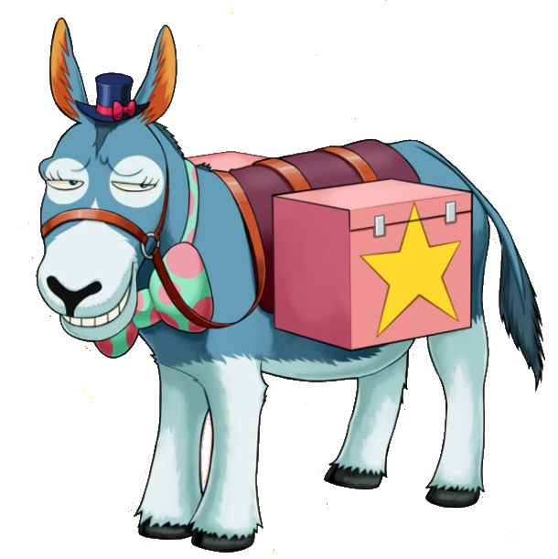
Project Brief
You have been hired by Donkey Games, a small games developer in Dundee. We are planning our next release and want to use data to decide what kind of game to make.
We want to understand what types of games are successful, and what factors contribute to their success. In particular we are looking for analysis that helps us decide which direction to take our company in.

Slide 3
Glossary
Steam - Digital distributor for PC games and software
Steam Workshop - Built in modding support for a game on Steam
Mods - Any custom content that has been created by a user to enhance a game (or make it worse)
Genres
Open World - a method of game design that allows the player to approach objectives freely, as opposed to more linear and structured gameplay. Essentially, the player has more freedom to interact with the game as they like, as opposed to strictly how the developer intended. (e.g Elden Ring, Legend of Zelda: Tears of the Kingdom, Elder Scrolls V: Skyrim)
Metroidvania - Portmanteau of Metroid and Castlevania - Genre of game that is centered on exploring a single map, using progressive unlocks to explore previously unreachable locations (e.g Hollow Knight, Bloodstained: Ritual of the Night, Axiom Verge)
Visual Novel - Genre of game that focuses more on communicating story like a novel would - generally has more of an emphasis on story and character interaction as opposed to gameplay (e.g Phoenix Wright: Ace Attorney, VA-11 Hall-A, STEINS;GATE)
Rogue-Like/Lite - Name taken from Rogue (1980) - Generally refers to games with a shorter gameplay loop, where you must start from the start when you die in game - Rogue-lites tend to have meta progression, such as increasing players stats between “runs” (e.g The Binding of Isaac, Enter the Gungeon, Dead Cells)
RPG - Short for Role Playing Game - Genre based on tabletop gaming, where you level up your character over the course of an adventure to become more powerful, typically with a focus on narrative and combat. Often used nowadays to say “you can level up your character” (e.g The Witcher, Divinity: Original Sin, Final Fantasy)
Platformer - Genre of game where the focus is getting a character to the end of levels by traversing various obstacles and challenges - Typically has a number of gameplay gimmicks to keep things interesting/challenging (e.g Super Mario, Spyro the Dragon, A Hat in Time)
Simulation - Game that typically simulates a role or job, but can be a simulation of a “world” - fantasy or reality. Typically very in-depth gameplay relating to whatever is being simulated (e.g Dwarf Fortress, Euro Truck Simulator, Papers Please)

Slide 4
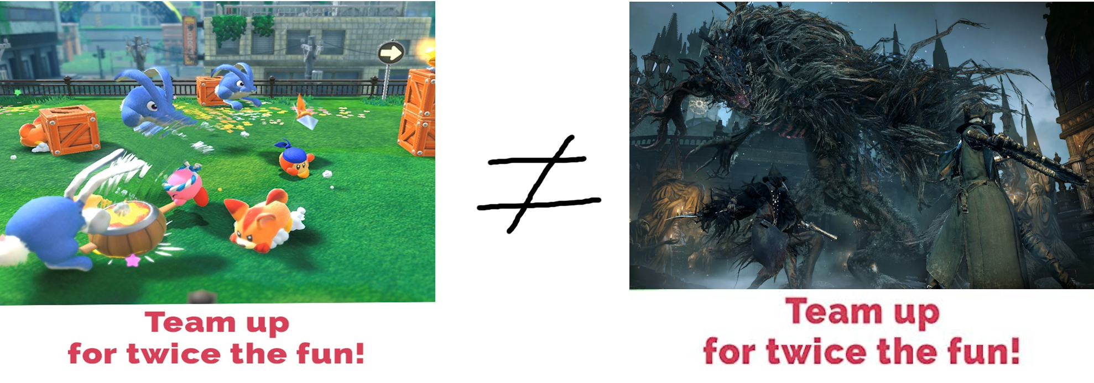
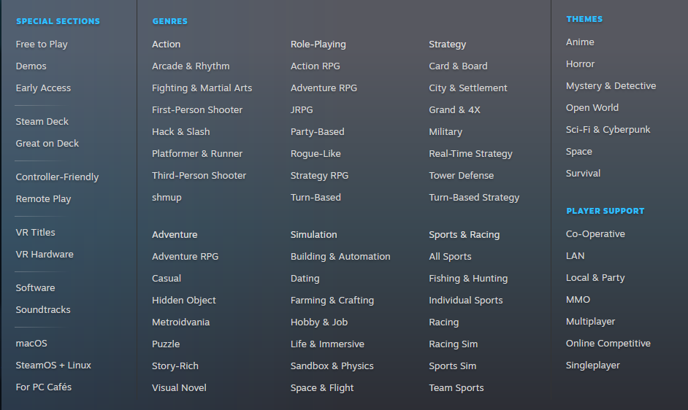
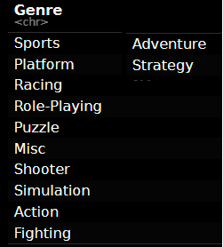
Things that should be addressed before we start
The data used is slightly out of date
The global games sales data set only goes up to 2019
The Steam data set only goes up to May 2019
I attempted to get a more up to date version of the Steam data, as the original author (Nik Davis, who can be found here https://nik-davis.github.io/) very helpfully included the steps he took to scrape and clean all the data from the Steam and SteamSpy API’s
However, this proved to be not possible to replicate in the limited time available - getting all 64,000 records from both API’s would have taken approximately 5 days.
Additionally, much of the data on games sales is historic, and presumably taken from the same databases, as they contain the same structure and data.
Attempts to find up-to-date sales figures / development costs from major players (e.g Nintendo, Sony, Microsoft) didn’t amount to much - It seems nobody is willing to share their data!
Genres are a little vague - Action, Adventure and Shooter, for example, don’t do much to describe a modern title, which tend to mix and match these older genre “tags”.
These are holdovers from a time when it was easier to describe a game, as they had much smaller scope
Steam data - I decided to use Steam’s data for much of my analysis, it was the best available dataset to represent current game sales. This means any analysis may not reflect the industry as a whole. It’s likely that each System has a different audience and ecosystem

Slide 5
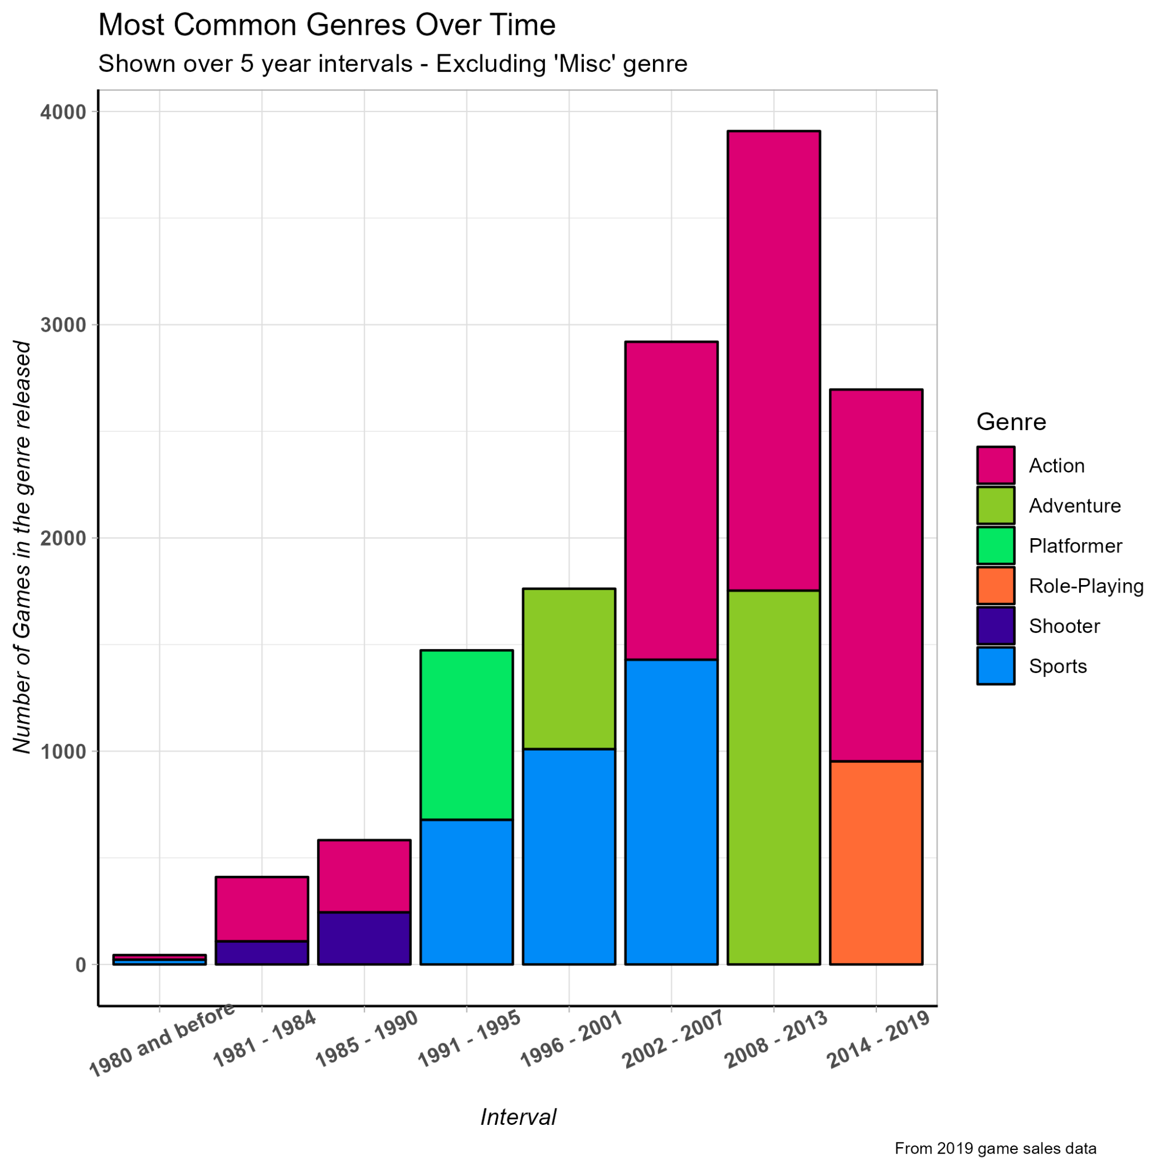
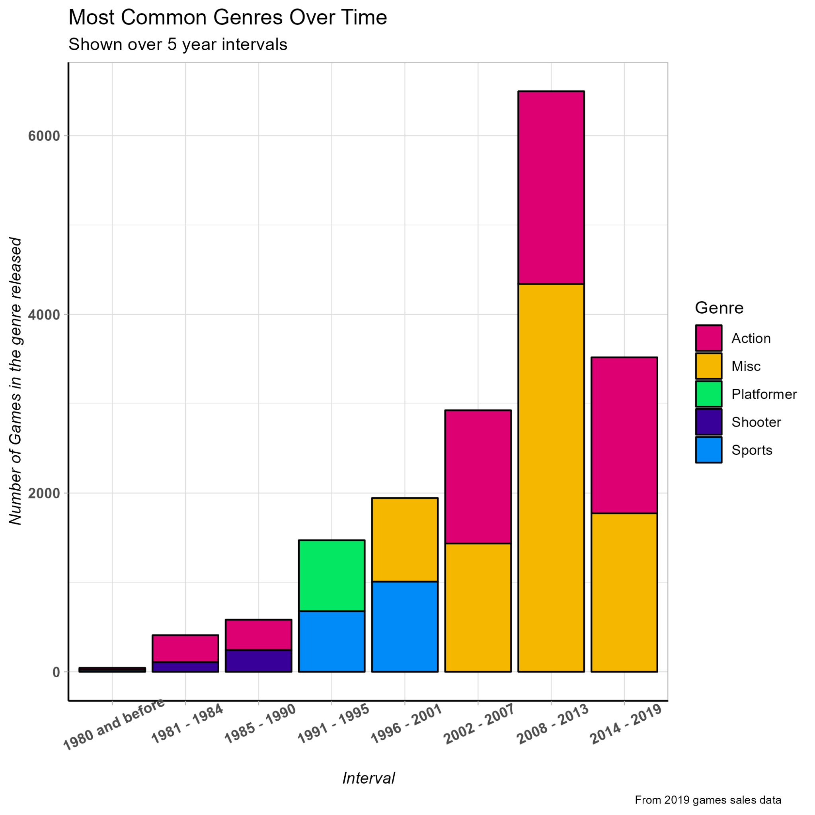
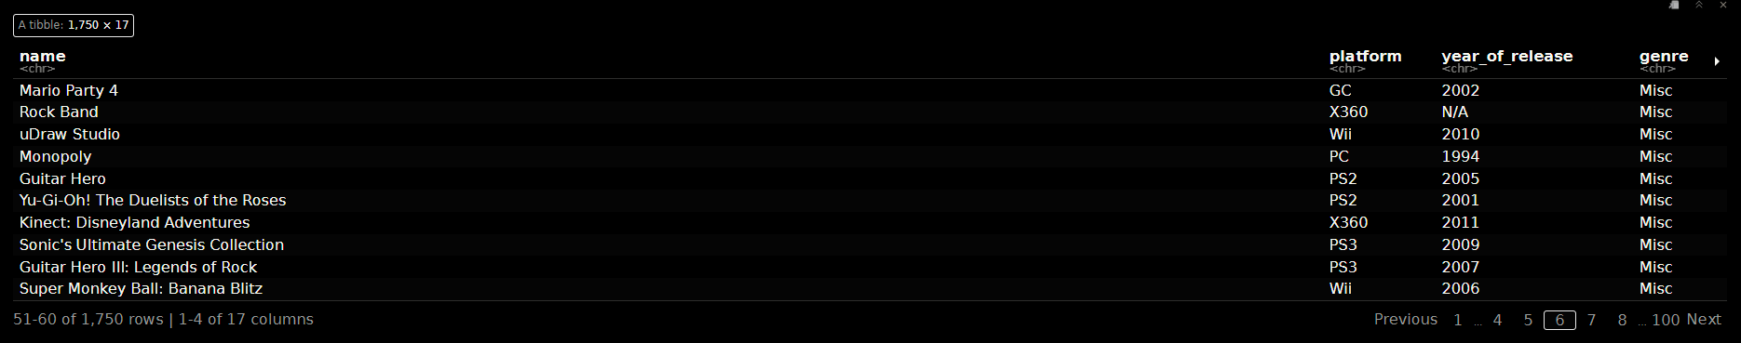
What was generally popular?
Historically, Action, Shooter and Platformers seem to have done well.
As we approach the dawn of systems capable of 3D graphics and more complex games, we see a shift into more “Miscellaneous” titles
Looks like these are games that don’t fit into a specific genre easily - Not very insightful really
But what are “Misc” games?

Slide 6

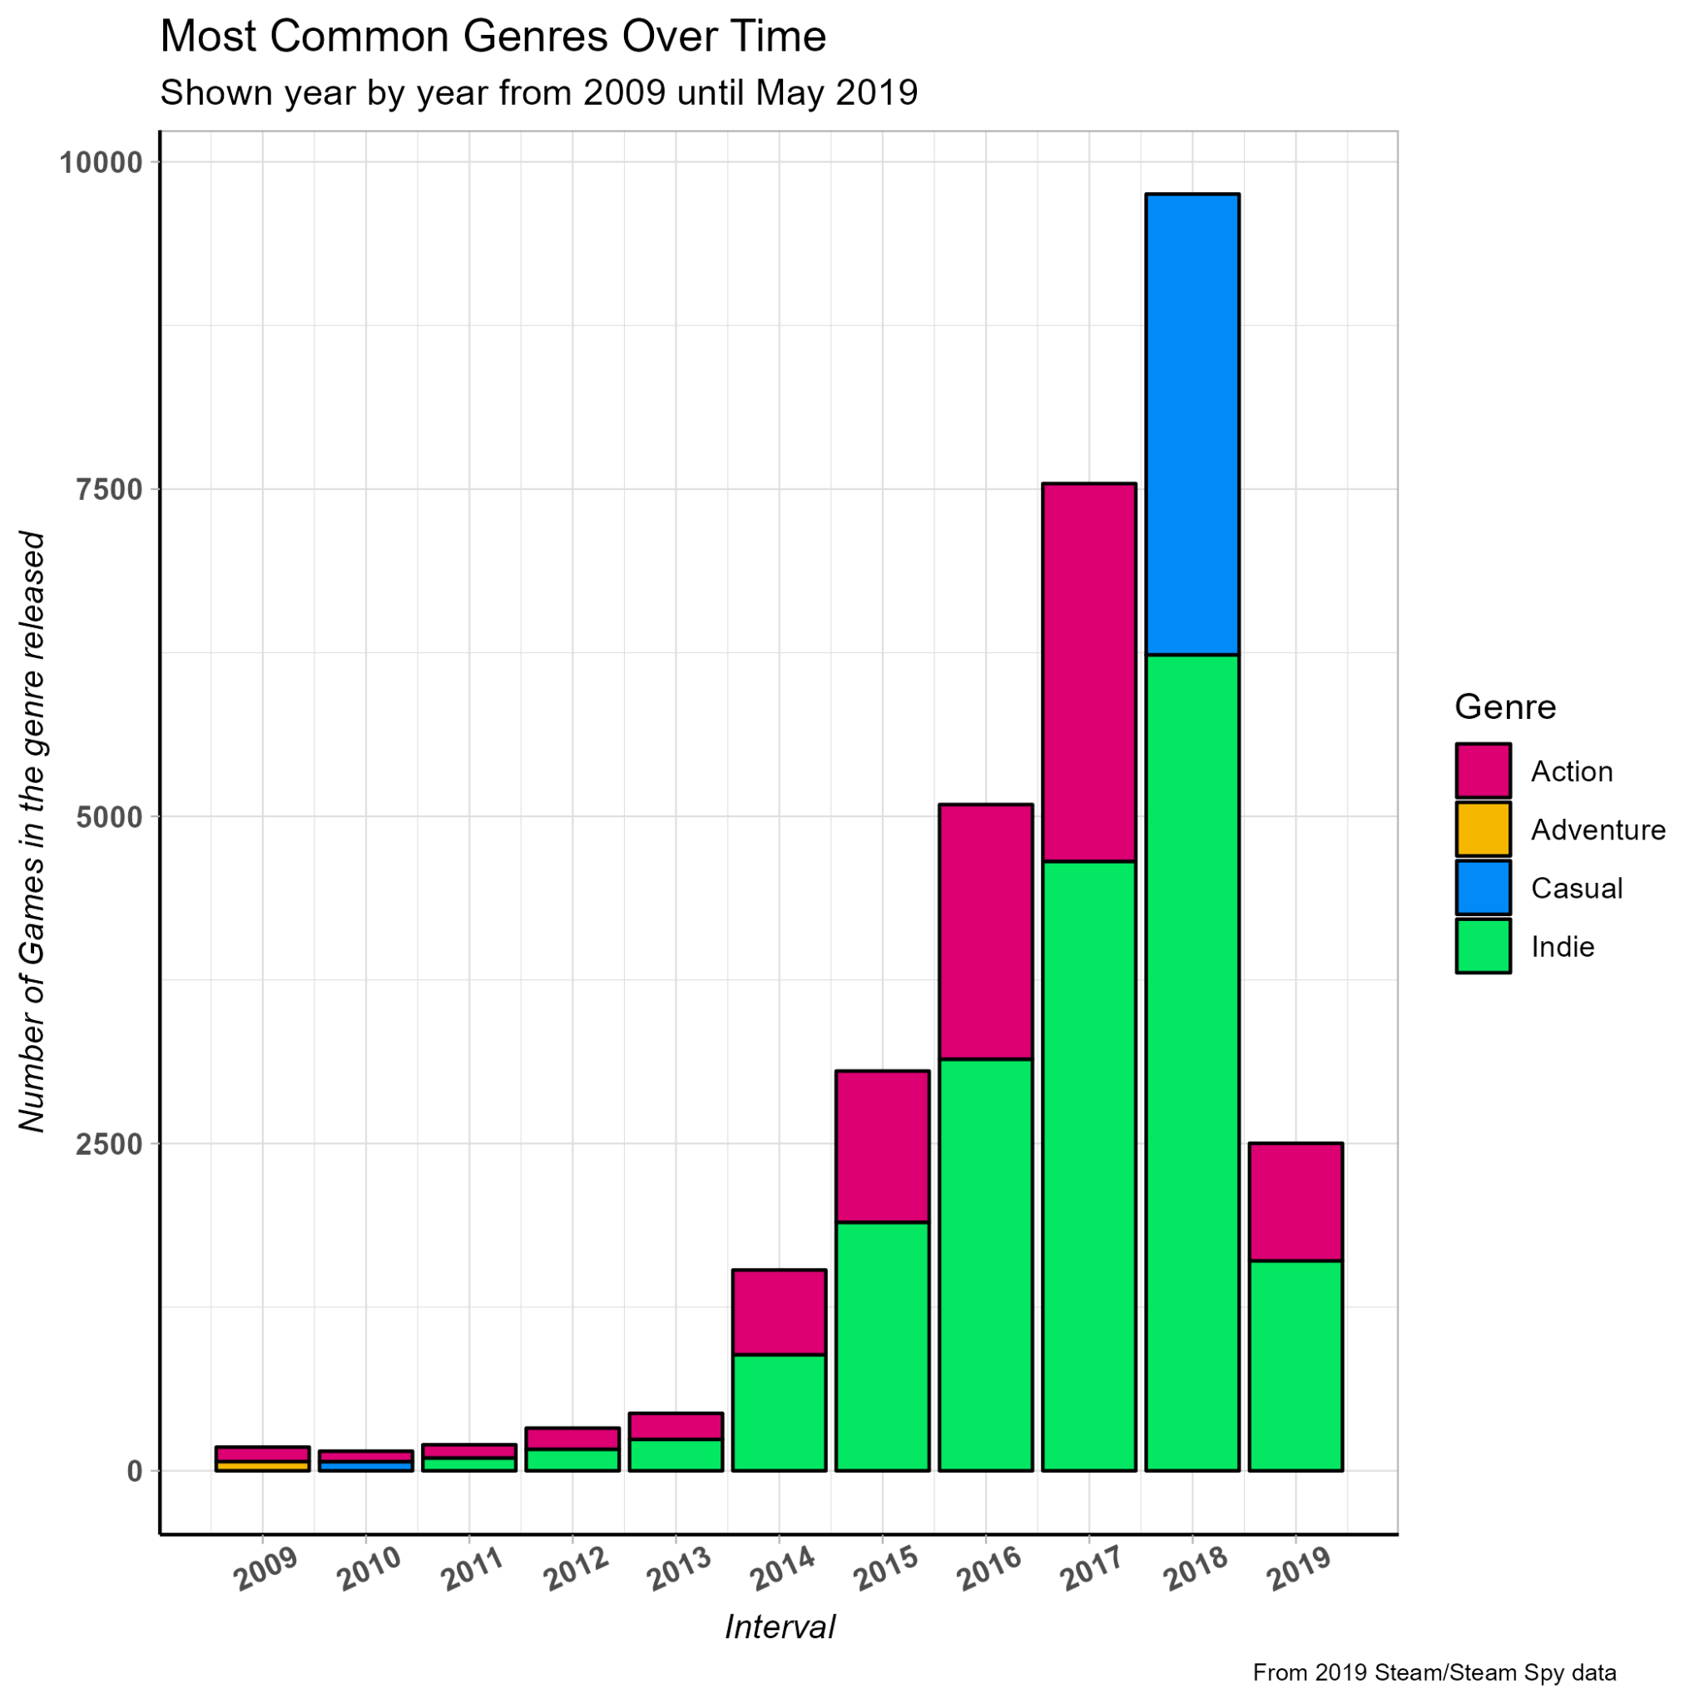
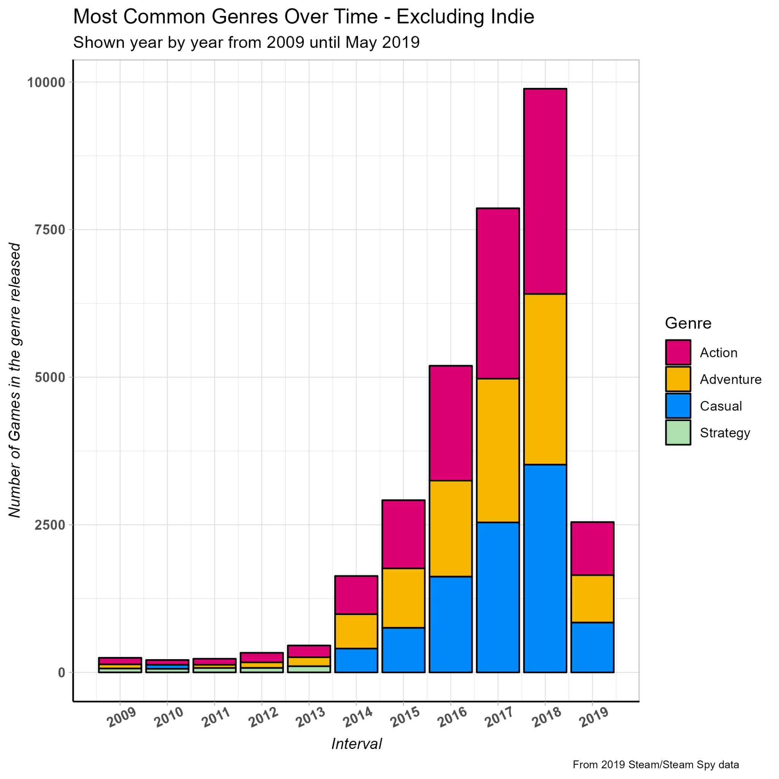
What’s popular on ?
We can see from this graph that we have a similar situation as our historic games sales graphs - action games are the most common releases
That is, aside from Indie.
Again though, What is an Indie game?
From Wikipedia: An indie game, short for independent video game, is a video game typically created by individuals or smaller development teams without the financial and technical support of a large game publisher, in contrast to most "AAA" (triple-A) games.
But first, what is Steam?
From Wikipedia: The service is the largest digital distribution platform for PC gaming, with an estimated 75% of the market share in 2013 according to IHS Screen Digest. By 2017, game purchases through Steam totaled about US$4.3 billion, or at least 18% of global PC game sales according to Steam Spy. By 2021, the service had over 34,000 games with over 132 million monthly active users.
Notes:
Personally, I don’t like including Indie with genres, as i don’t really believe that it’s really a “genre” - An indie game is indie due to its development, rather than its contents. Regardless, we can still see that they make up the vast majority of releases.
So, we can see what is and has been popular
But can we predict what genre will do well?
If we can, what elements help contribute towards success?

Slide 7
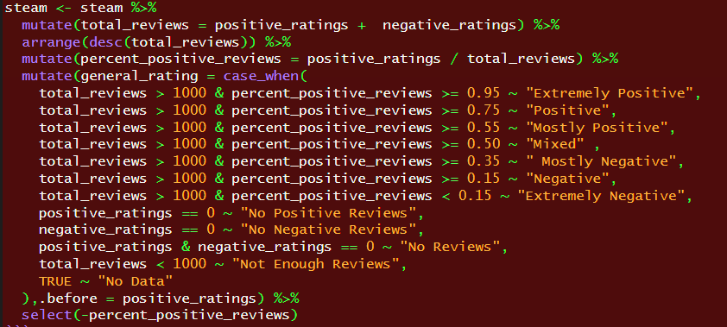
What makes a game successful?
Sales
Instead, I used reviews
Summed positive and negative ratings to find the total number of reviews
Created classifiers based on the ratio of positive to total reviews
So what factors might contribute to a game being well reviewed?

Slide 8
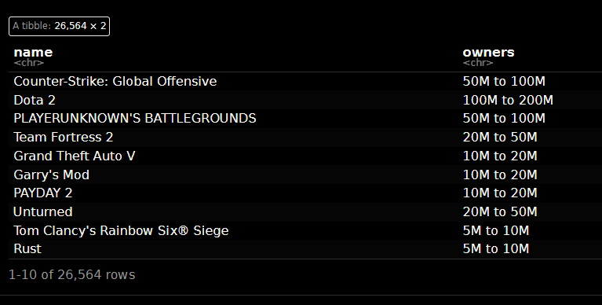
Decision Trees & Random Forests
Extremely Positive
Positive
Mostly Positive
Mixed
Mostly Negative
Negative
Extremely Negative
In the first few forests, I set the target to be positive ratings - Any rating above “Mixed”
This was due to the Steam dataset not having exact sales data - Owners wasn’t a good metric, as they came in broad ranges
Additionally, “owning the game” does not necessarily translate to “purchased the game”

Slide 9
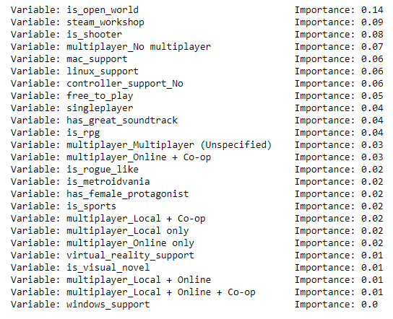
Run 1 - 100 estimators
This initial run used less estimators, but had multiple dummies for multiplayer.
We can see that of all the factors and genres, is_open_world seems to be the most influential on getting a positive review score.
Having no multiplayer be of higher importance may be due to the number of multiplayer games being lower than single player:
5758 games with the tag as opposed to 20,806 without!
Notes:
What is an open world? Wikipedia defines it as a method of game design that allows the player to approach objectives freely, as opposed to more linear and structured gameplay. Essentially, the play has more freedom to interact with the game as they like, as opposed to strictly how the developer intended.

Slide 10
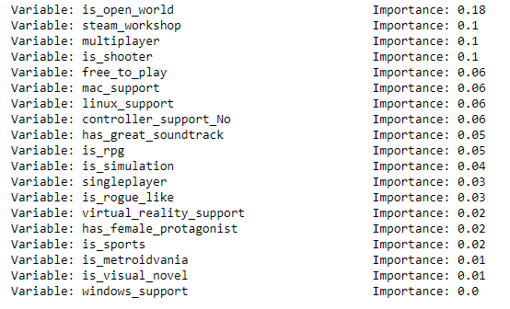
Run 2 - 500 Estimators
This run had more estimators, multiplayer changed to a binary True/False, and added the additional variable is_simulation.
Again, is_open_world was the most influential variable

Slide 11
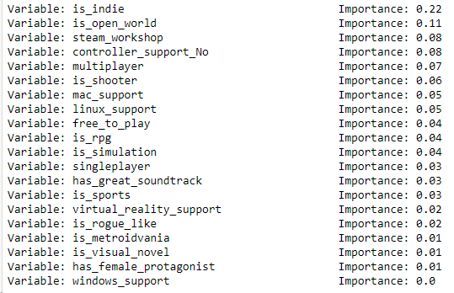
Run 3 - 500 Estimators
In this 3rd iteration, the variable is_indie was added.
This overtook is_open_world as the most influential variable - This isn’t surprising, as it’s by far the largest “genre” in the data set

Slide 12
What if we change the threshold?
It could be argued that “Mostly Positive” isn’t really a standard to aim for.
Extremely Positive
Positive
Mostly Positive
Mixed
Mostly Negative
Negative
Extremely Negative
So what if we change things up a bit - a game is only considered “positive” if it’s within this threshold

Slide 13
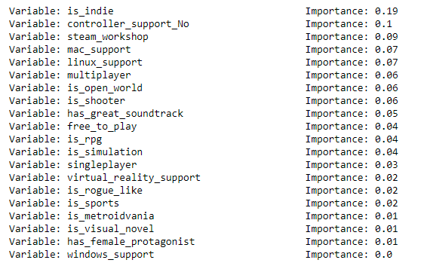
Run 4 - Higher Thresholds
Here we can see that is_indie is still the most important factor.
However, genres such as is_open_world, along with a few others, have dropped in importance.
Other factors, such as other mac/linux_support and has_great_soundtrack have gone up.
However, we already know that is_indie isn’t a useful factor for deciding what direction to take a game in - What does it look like if we remove it?

Slide 14
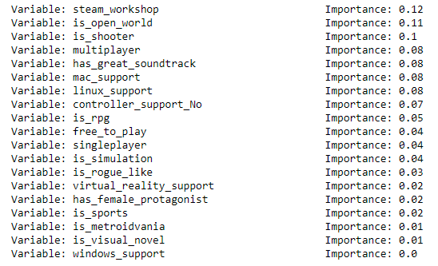
Run 5 - Same again, without Indie
With is_indie removed, surprisingly steam_workshop has emerged as the most important factor in positively reviewed games. (but there isn’t much in it)
is_open_world and is_shooter have moved back up, suggesting that, again, these are genres that tend to get positive reviews.

Slide 15
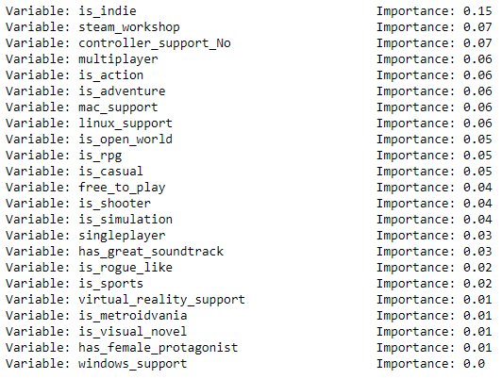
Run 6 - Added Action, Adventure and Casual
In this final run of the model, is_action, is_adventure and is_casual were added.
is_indie remains the most important factor in a game being positively reviewed

Slide 16
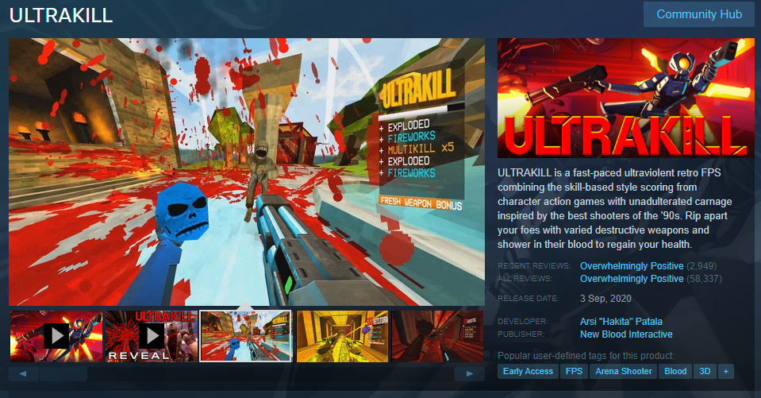
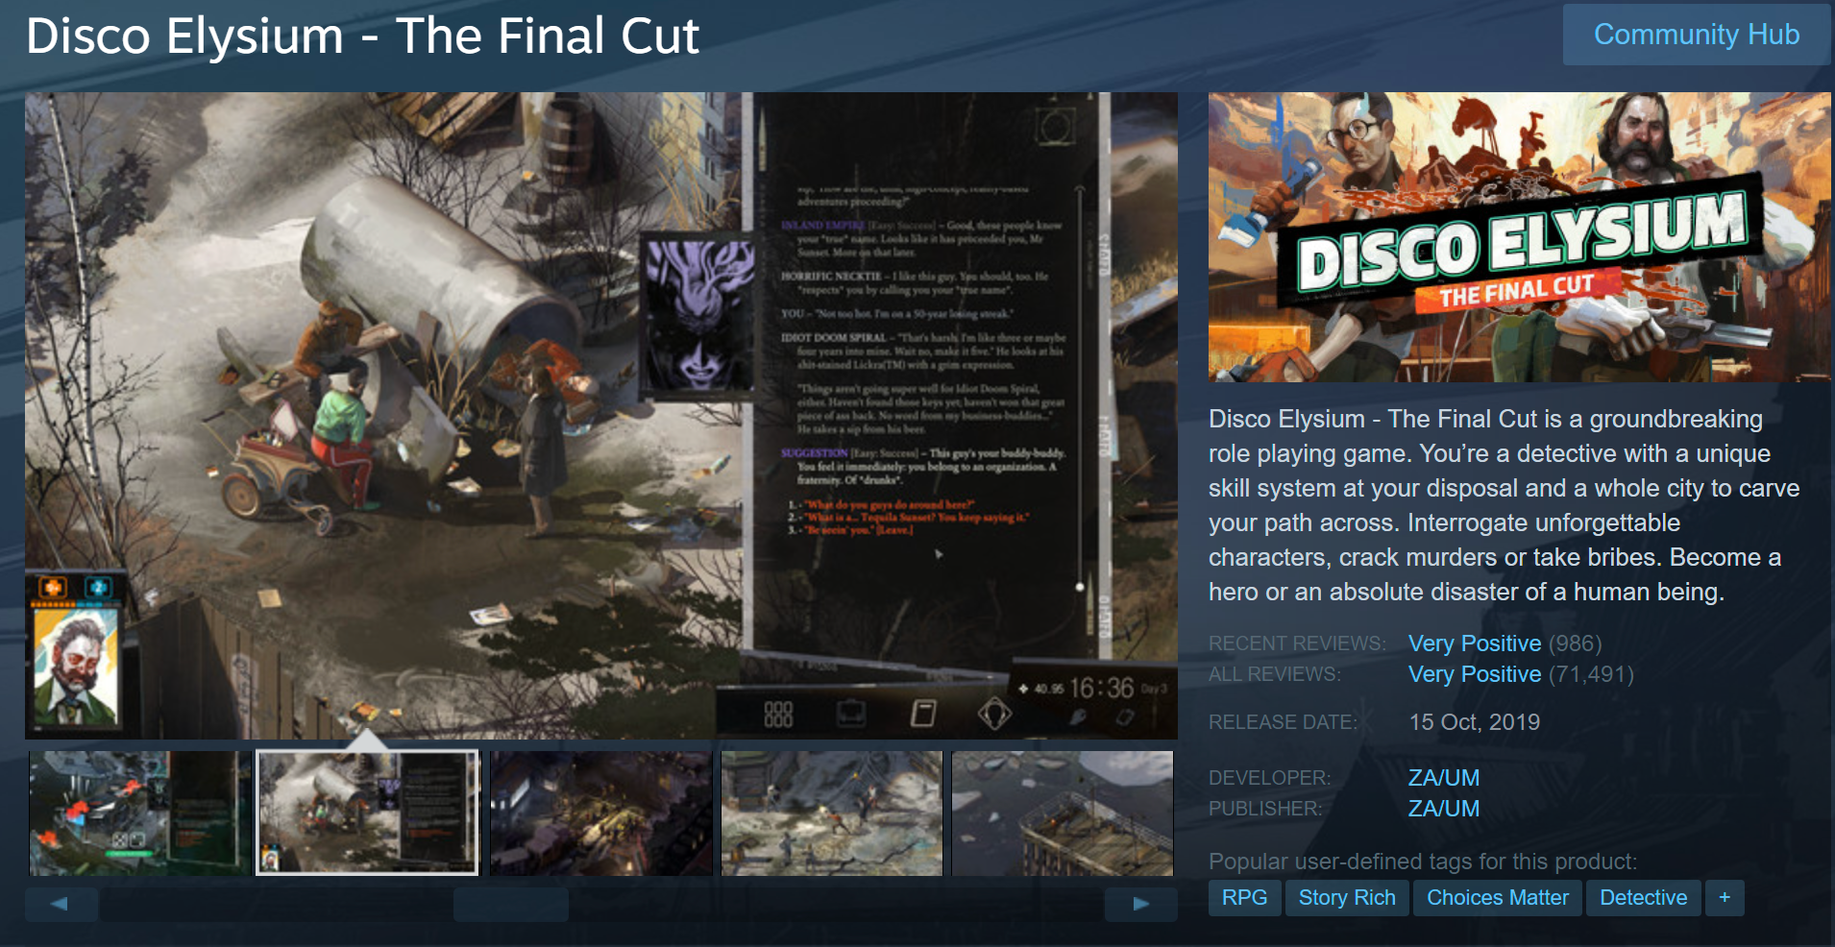
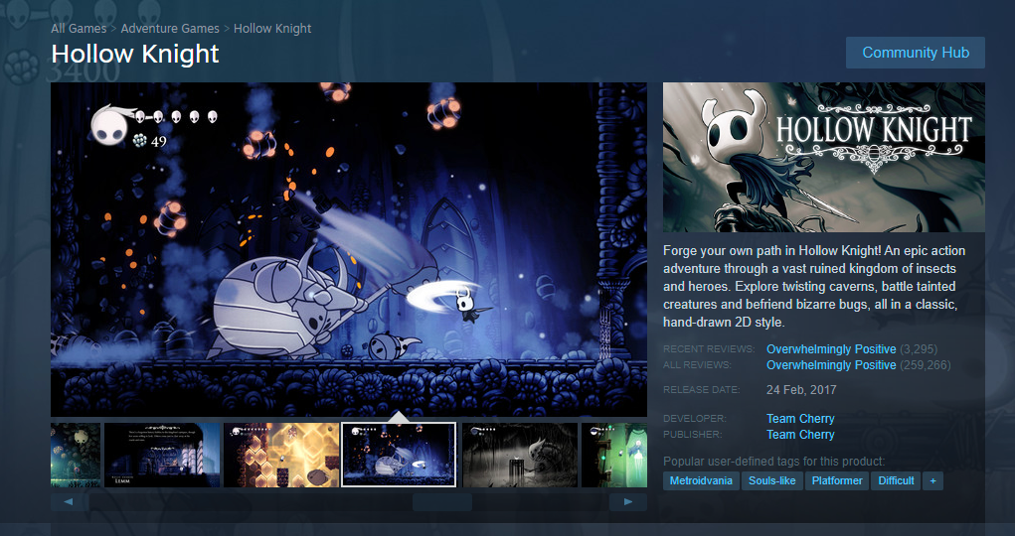
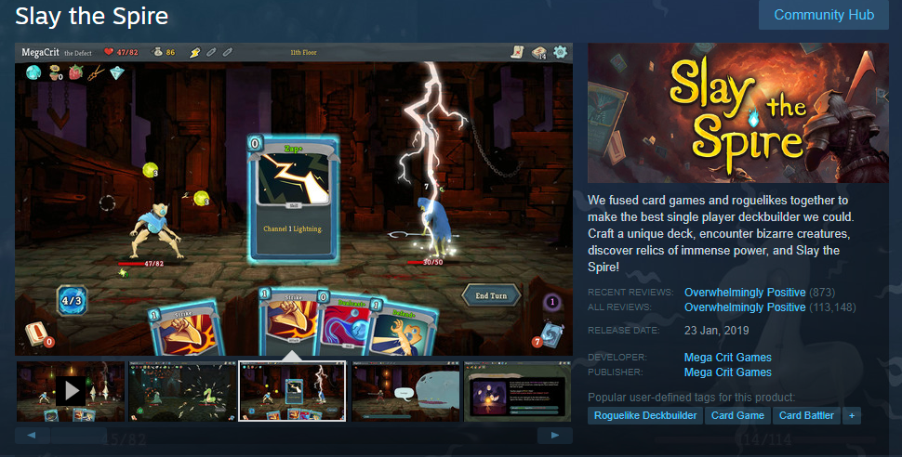
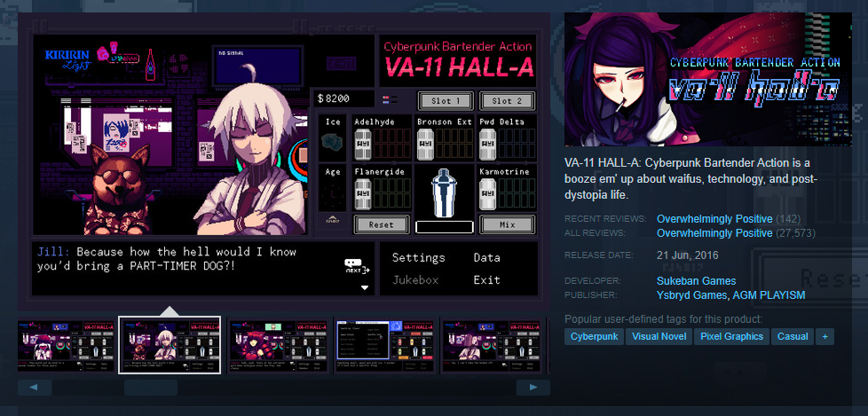
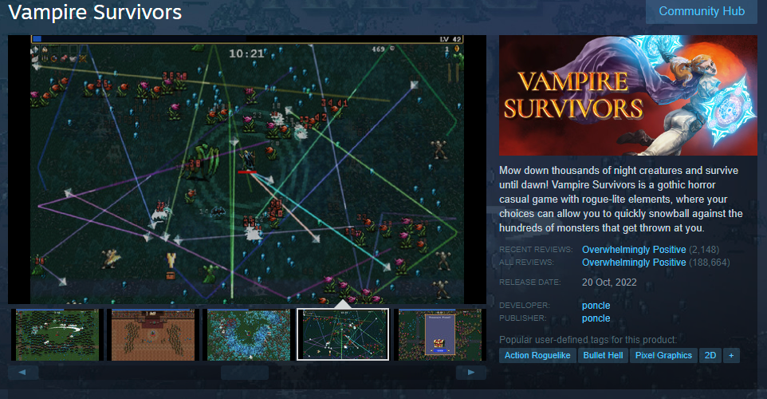
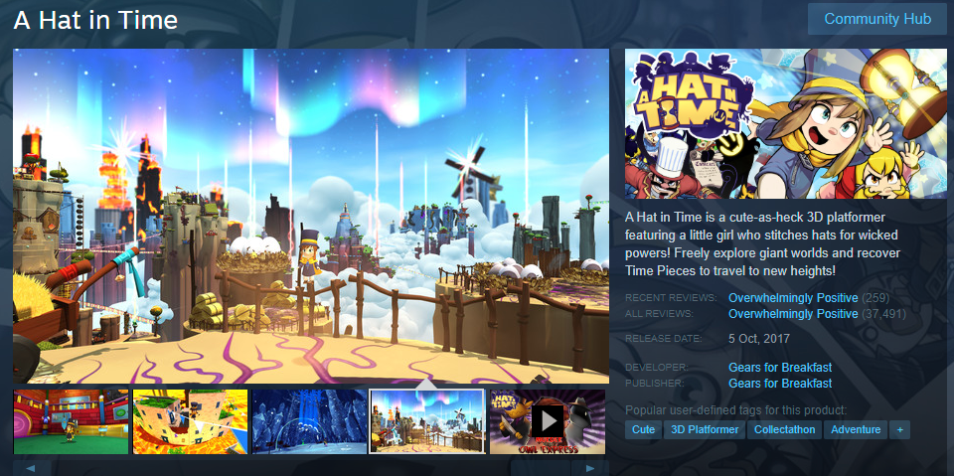
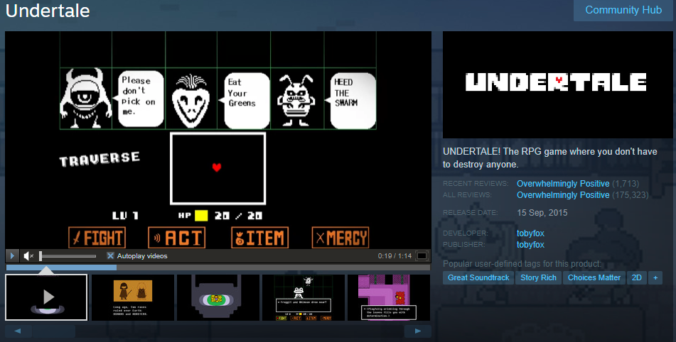
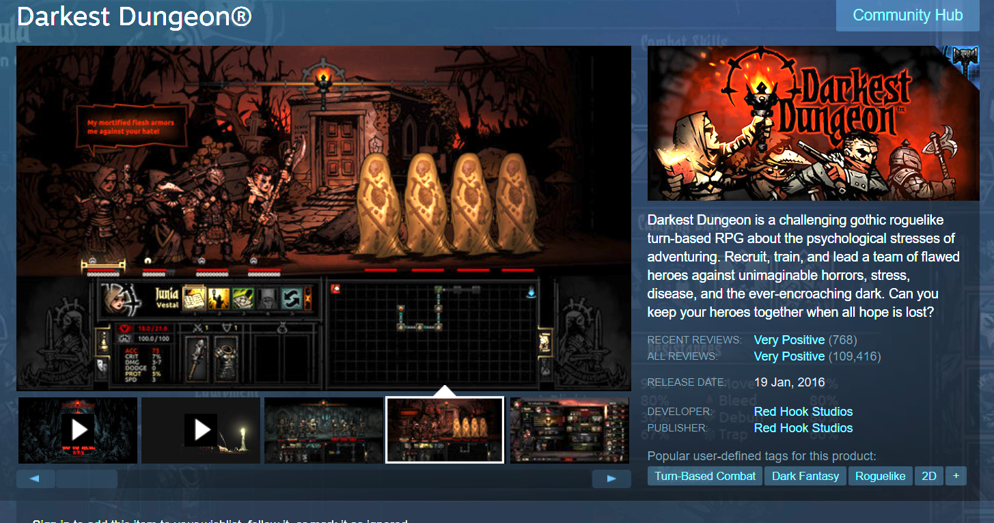
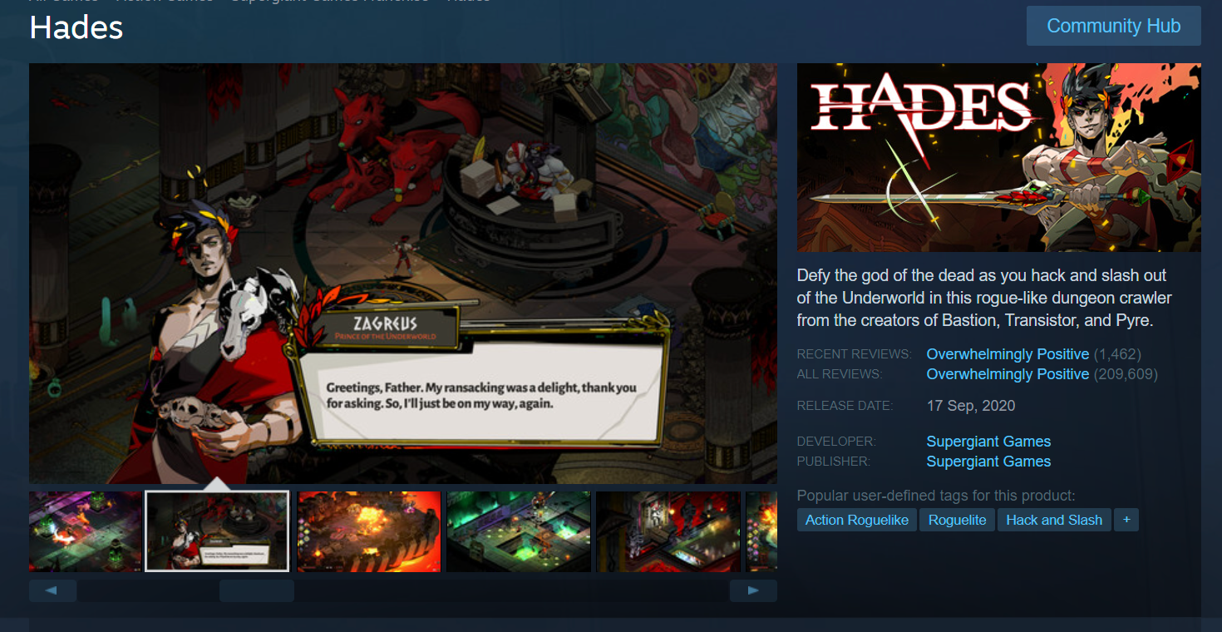
So what does this tell us?
Open world is a pretty popular genre! (at least of the genres we’ve included)
Games with the “Indie” tag tend to get better reviews than those without
But this isn’t that important in this case - By definition, Donkey games would be making an indie game
Windows support has little to no importance - However, this may due to the fact that Steam primarily caters to Windows.
Mac and Linux support seems to have a positive influence on reviews. However, given additional development time and cost associated with developing for multiple OS’s, it may not be that important to focus on.
It must be stressed that any genre that hasn’t made much of an impact on the model shouldn’t just be discounted
There are examples of these genres doing extremely well - Just because they aren’t what’s popular, doesn’t mean they couldn’t be!
Many of the most popular Indie titles defy genre, or even redefine them!

Slide 17
Reviews and Sentiment Analysis
So we know that people tend to review Indie games better - we can also interpret that as we get into positive territory, non-gameplay factors such as the soundtrack, or support for multiple OS’s begin to matter more and more.
But then what do people have to say about these positively reviewed games?
And we can’t just focus on the positive, what makes a bad game?
To investigate this, I took a dataset of Steam reviews, and took a sample of :
1 Million positive reviews
1 Million (or so) negative reviews

Slide 18
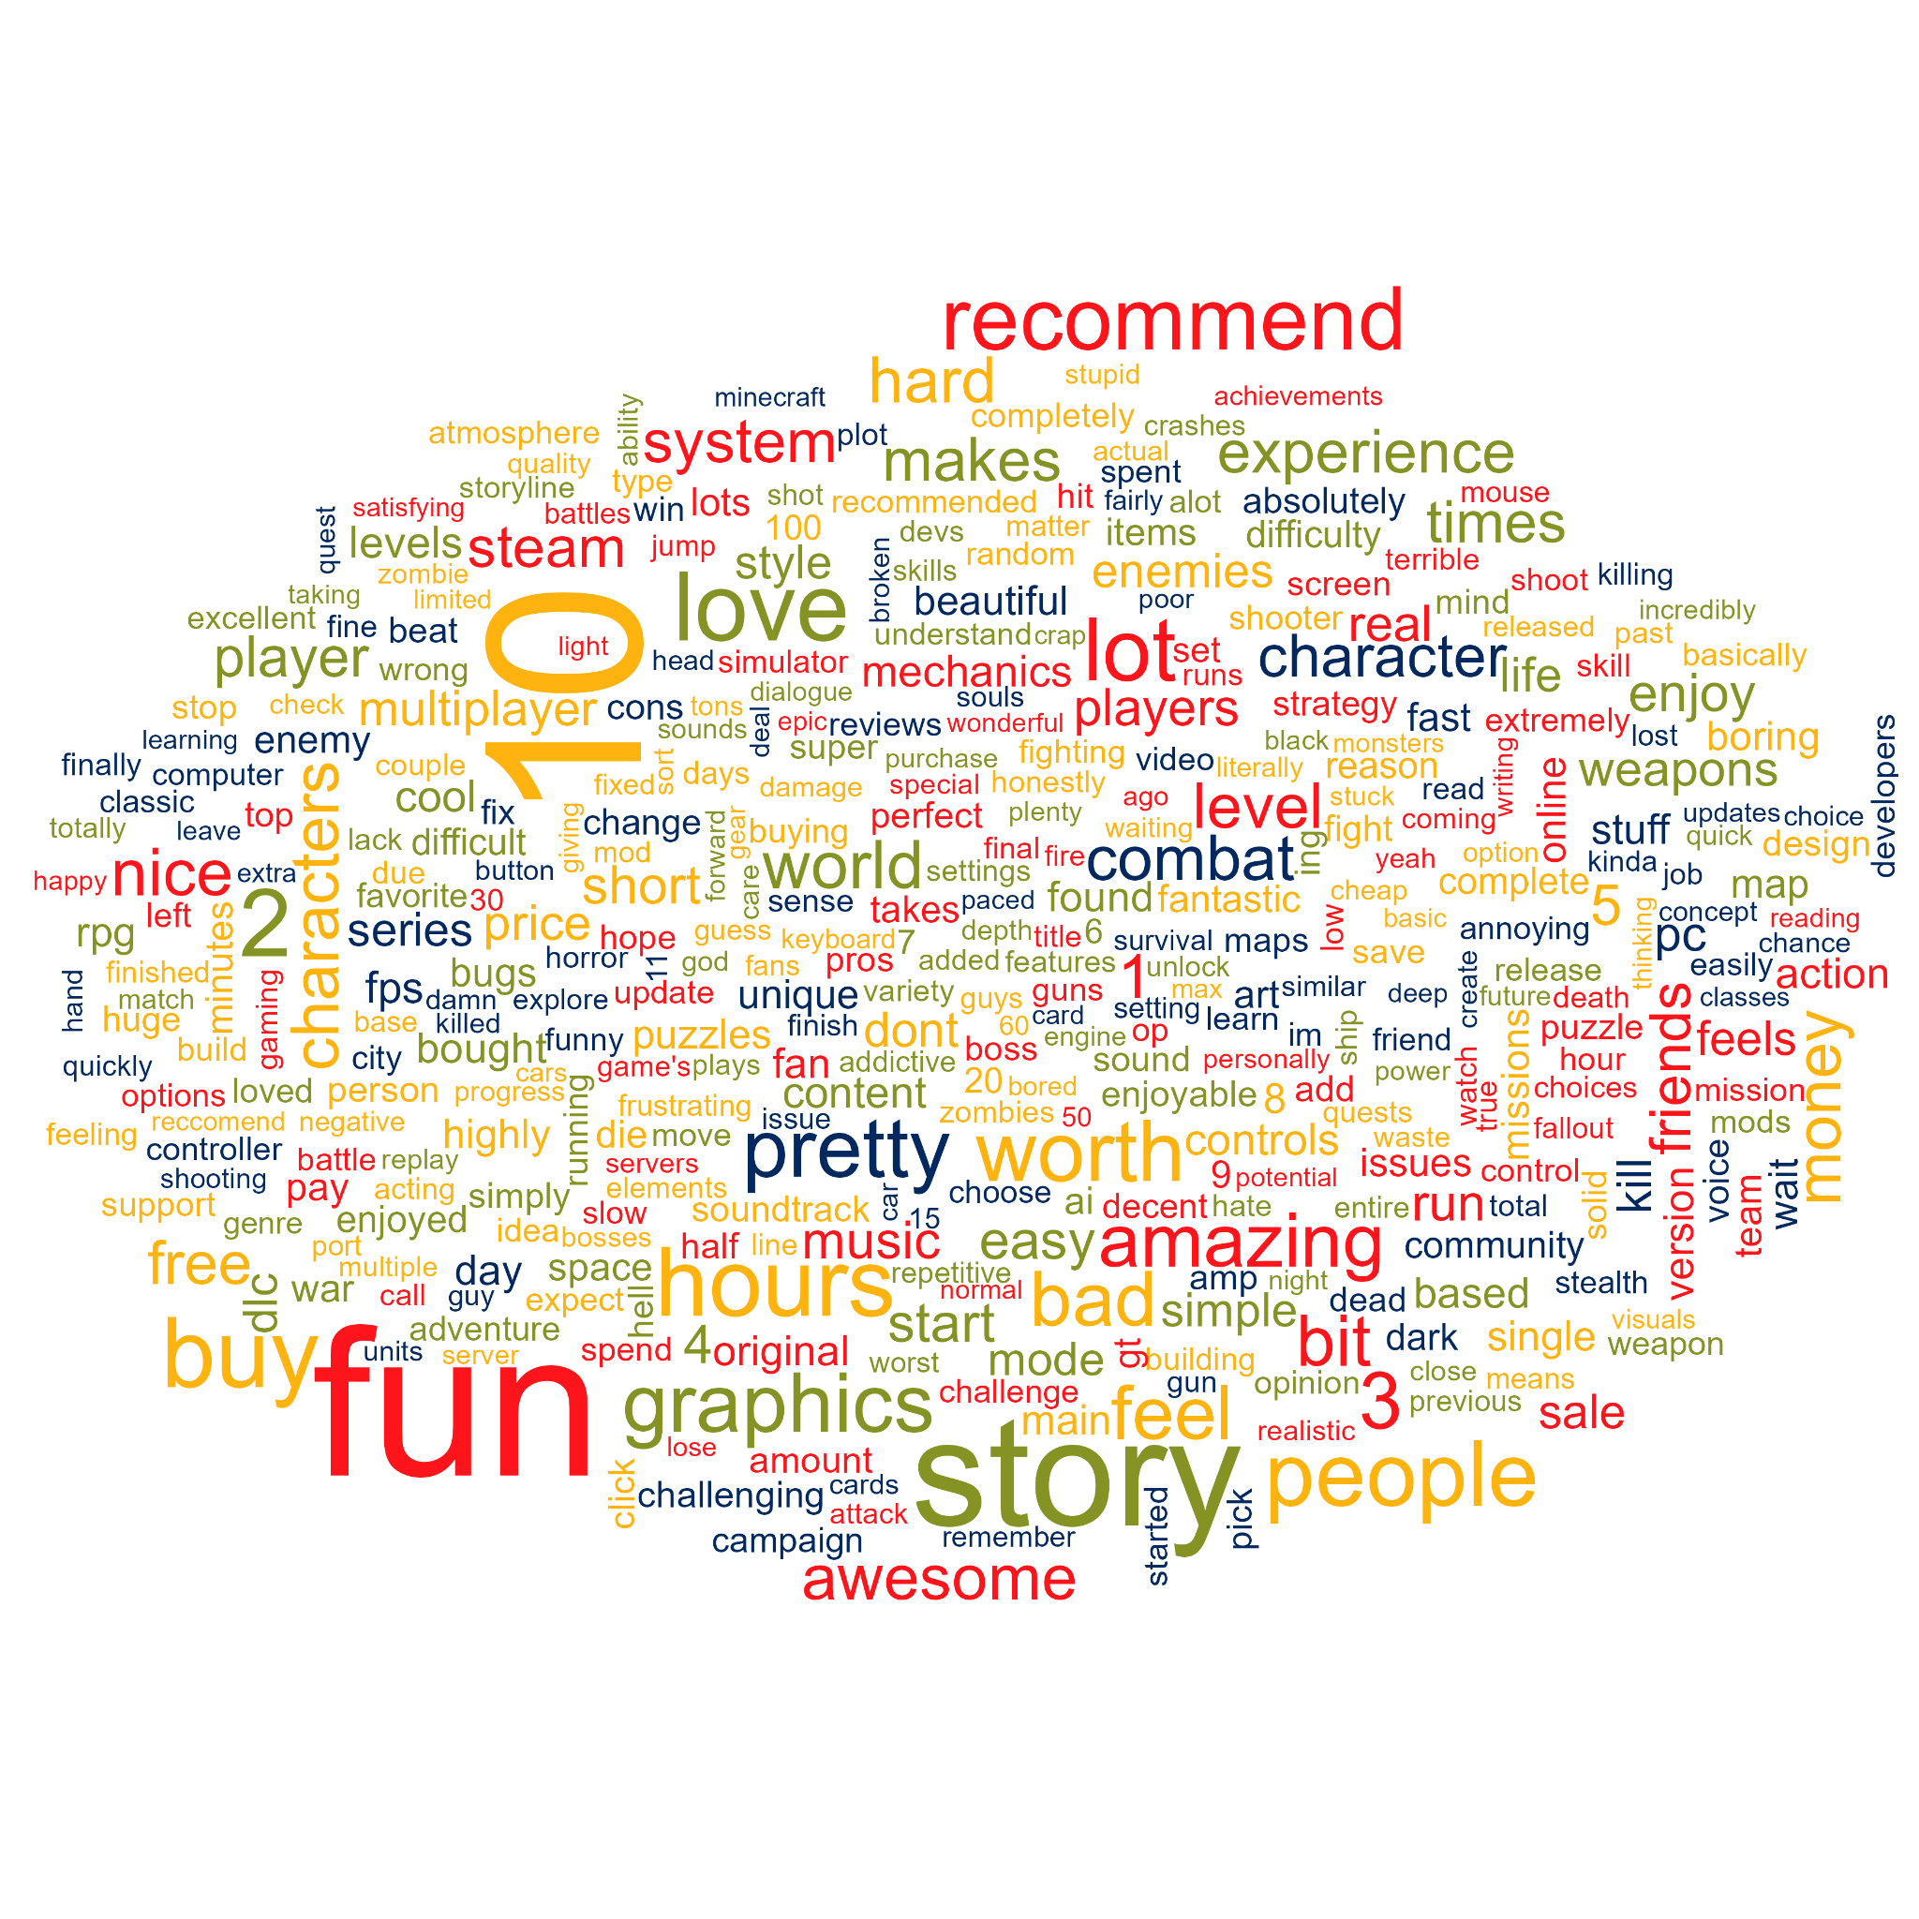
Positive - One word
Here, we see some words that appear more than 8000 times in positive reviews.
Quite a lot to take in here!

Slide 19
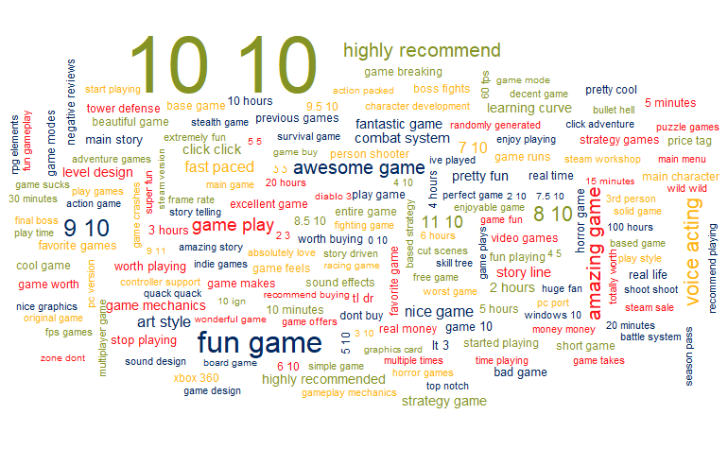
Positive Bigrams
These seem to be a little less useful than singular words - but there are still some good insights hidden here.
Main character, voice acting, graphics, sound and other elements are mentioned here
It’s safe to assume that if people repeatedly mention them in reviews, it’s probably something worth keeping in mind!

Slide 20
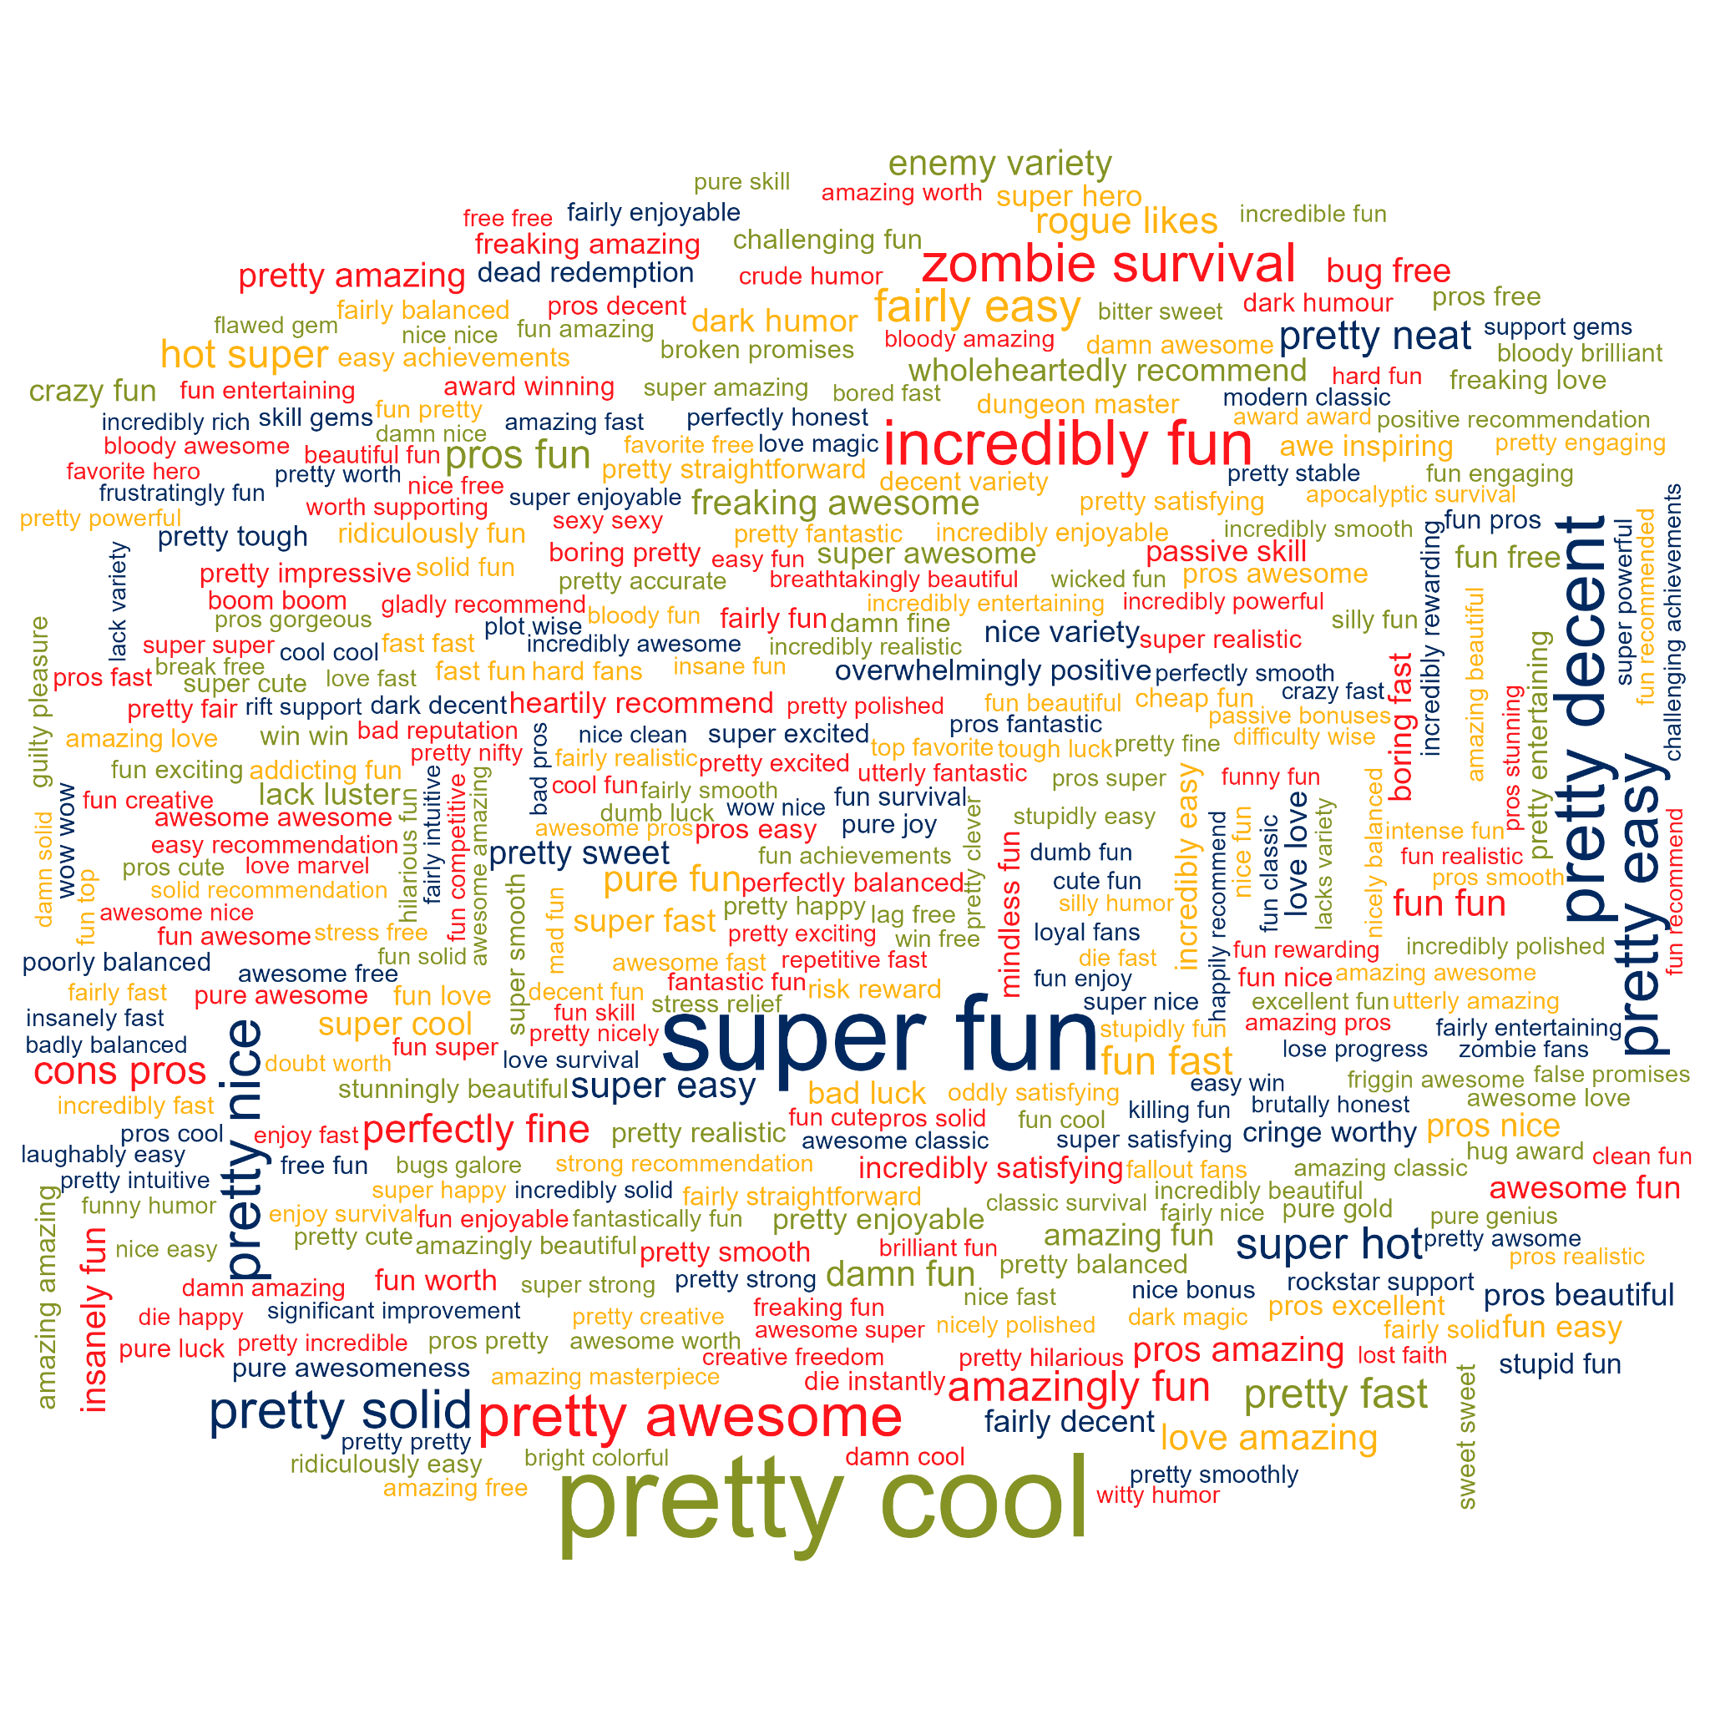
Positive Bigrams - With sentiment analysis!
This wordcloud was produced using sentiment analysis - each bigram was given an overall “sentiment” , and only positive ones were included
Again, an overwhelming amount of information - but amongst the general praise, we can see some useful concepts
Bugs (or their absence), polish, variety and visuals all get mentions - Again, good things to focus on

Slide 21
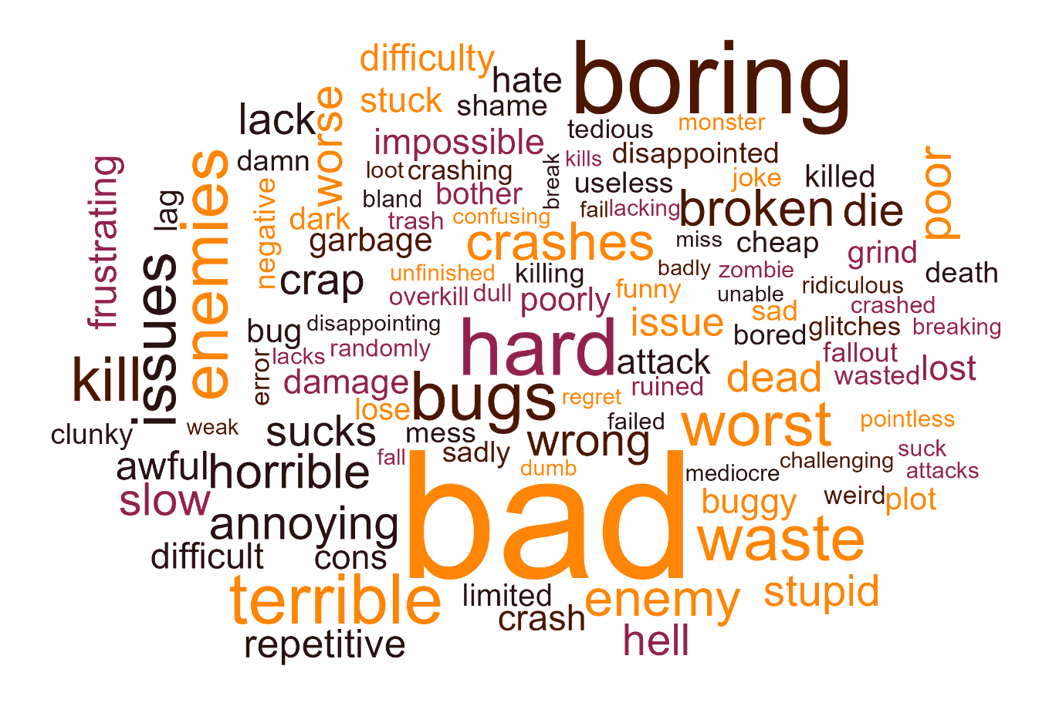
Negative words
“boring” appears
78,001 times!
We can also learn a lot of what not to do from Negative reviews - This example shows negative words that appear over 8000 times
“bad” appears over 140,000 times!

Slide 22
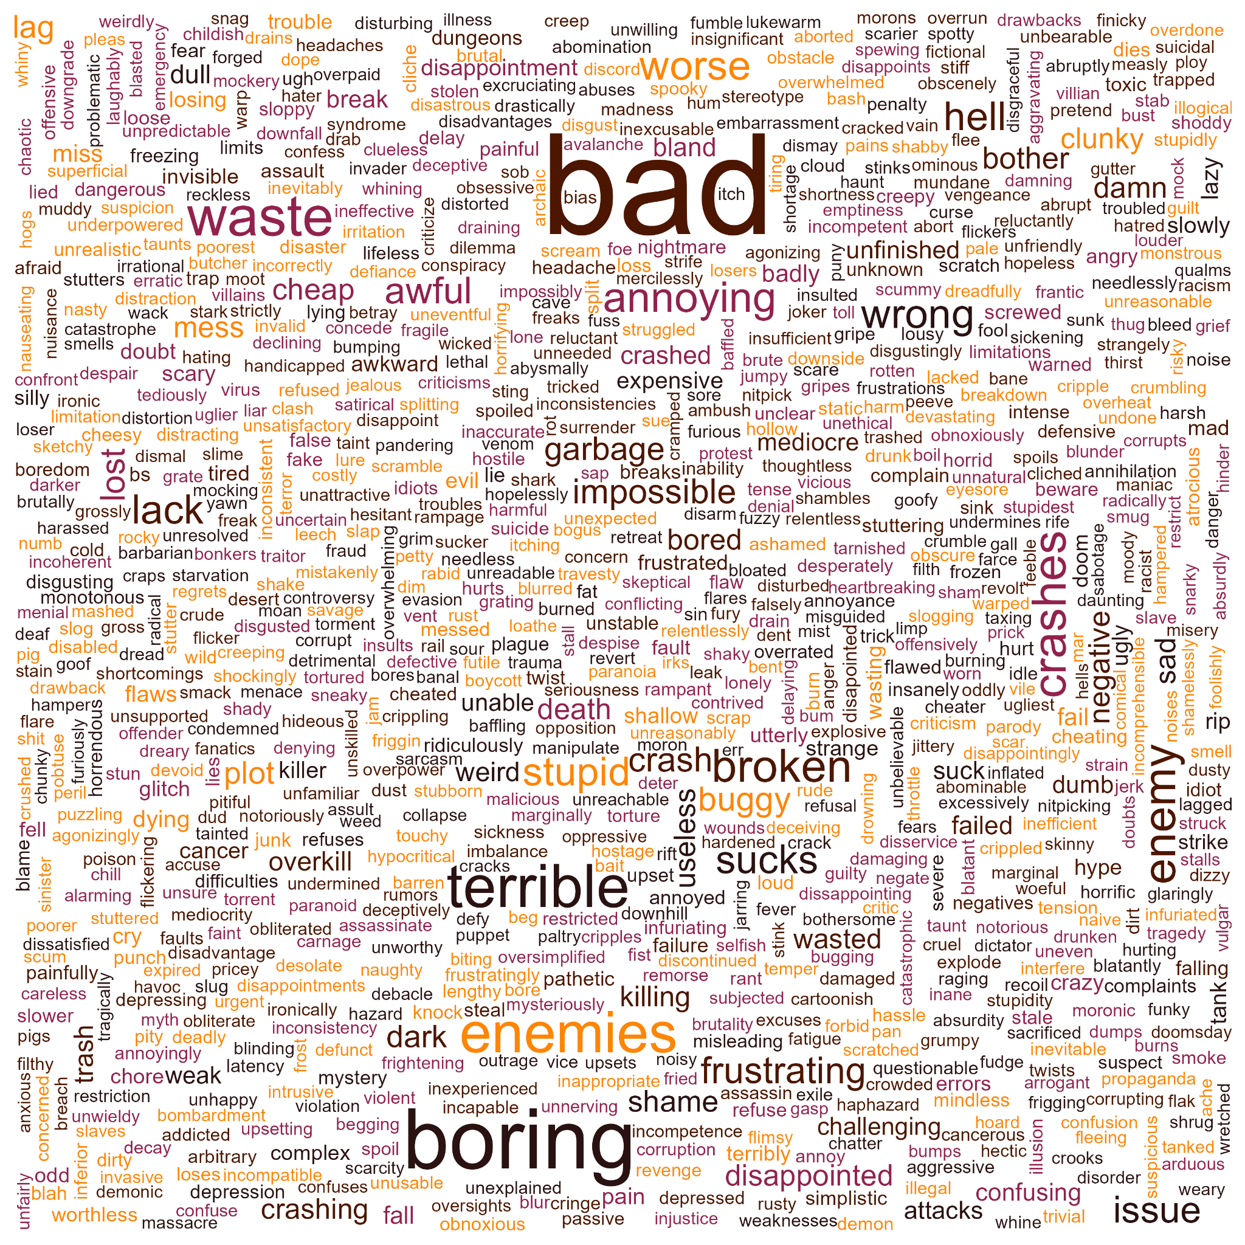
You could spend all day looking at all the negative things people have to say

Slide 23
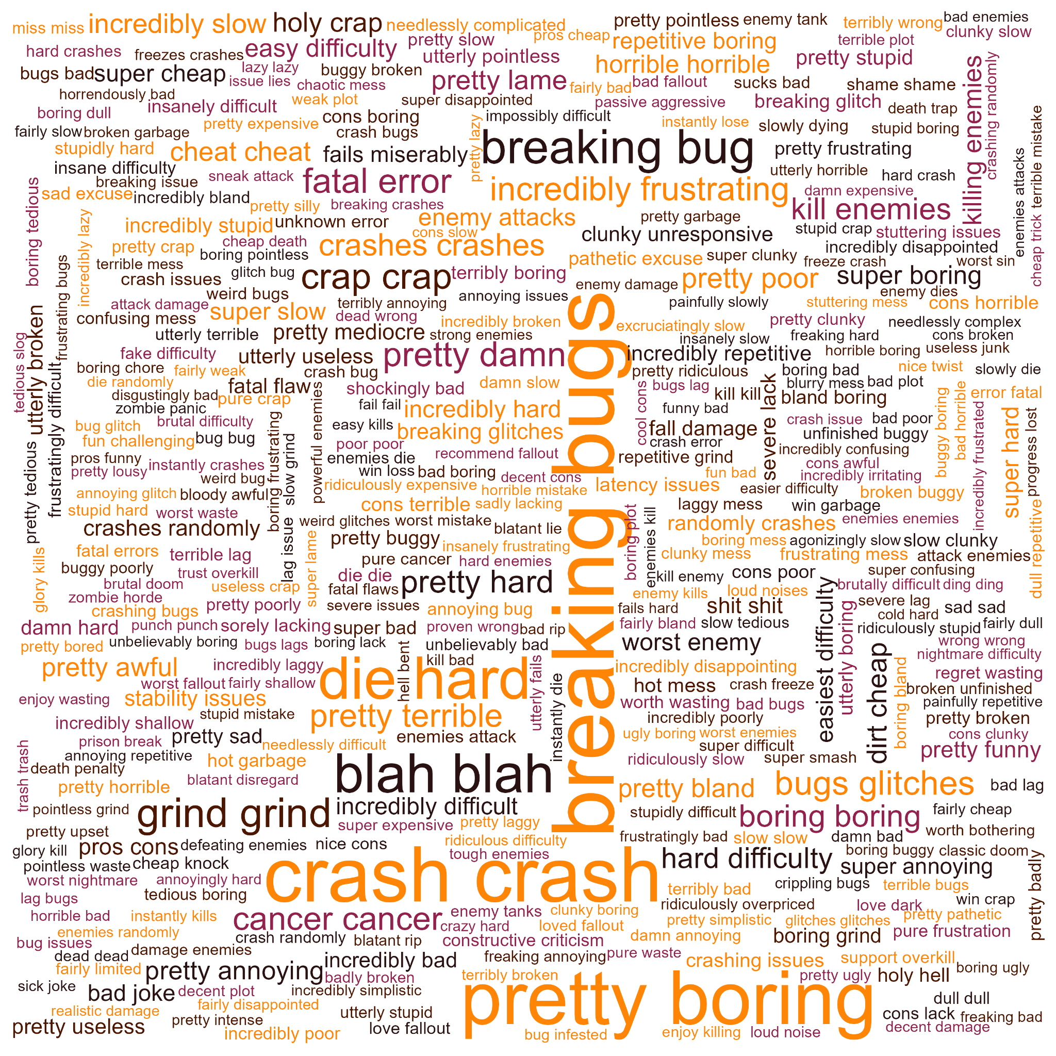
Negative Bigrams
There are many, specific things that people clearly do not like in games.
Alongside personal gripes (such as difficulty), there are plenty more examples of people complaining about the game not functioning

Slide 24
So what can the reviews tell us?
Story, mechanics, combat, graphics, sound design and controls are all things that do get noticed in positive reviews - Make sure they’re up to scratch!
Perhaps the most important thing we can learn from the reviews is polish
With so many complaints of buggy, glitchy, unstable or just broken games, it’s very clear that people are not happy to spend money on a game that doesn’t work correctly.
This may seem like an obvious thing, but it’s clear that many fail to adequately polish their games, which ends up being detrimental to reception, and ultimately, sales

Slide 25
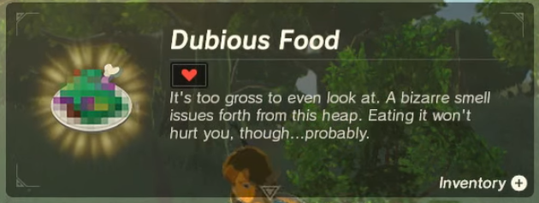
Conclusions
Genre is not the be-all and end-all for a game
People like things that aren’t big studio releases!
Polish your game - people complain about a buggy game more than a stable one
There is a lot more out there than what we can see in Historic sales data
There is more to a creative process than the tags you can attach to it
If you were cooking a meal for someone, you wouldn’t ask them for a big list of all the things they like, then try and throw it all into one dish

Slide 26
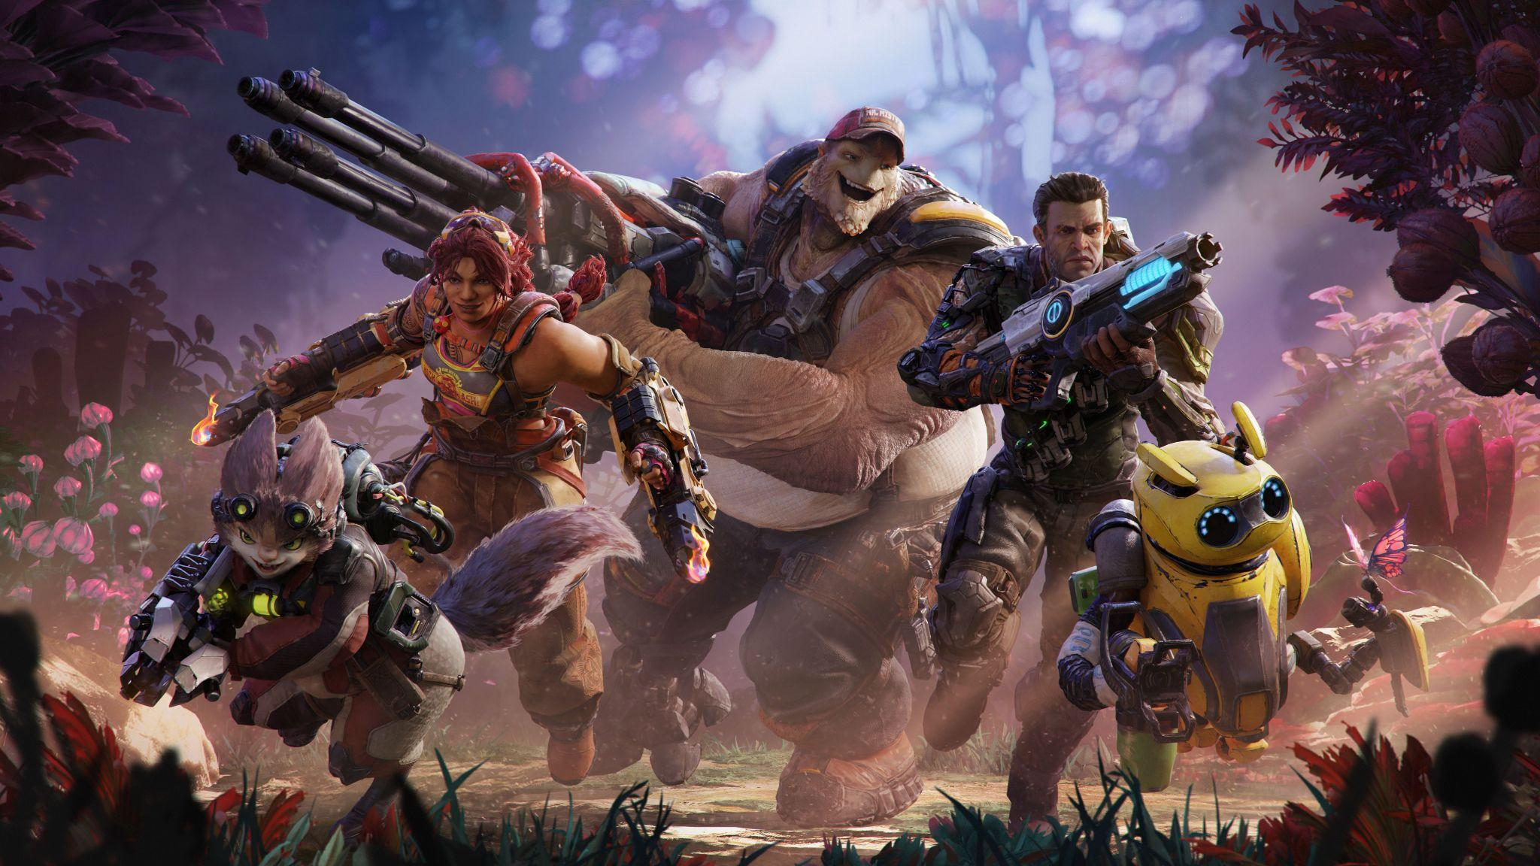

Crucible: A cautionary tale
In May 2020, Amazon released a game called Crucible
This game was a jack-of-all-trades shooter - It had esports ambitions, mimicked the gameplay and tone of several other popular games - It was a blend of Overwatch, Team Fortress 2, Monster Hunter and several other popular multiplayer titles.
In less than a month, it was dead in the water. Nobody was playing it - Nobody was watching it.
In May, when the game was about to be released, Amazon Games vice-president Mike Frazzini told the BBC the company wanted "to make games that resonate with a very large audience of players".
The game was pulled back into a closed beta state, and then, by November 2020, had been cancelled. Amazon had chased trends, attempted to mimic the success of others, and ultimately accomplished the laughable result of unreleasing a game they had worked on for 6 years.
Undoubtedly, Amazon studios tried to paint too broad a picture, using trends to try and predict something that was “guaranteed” to be successful, and ended up falling on their face
Notes:
Perhaps we can all learn something from Amazon here -

Slide 27
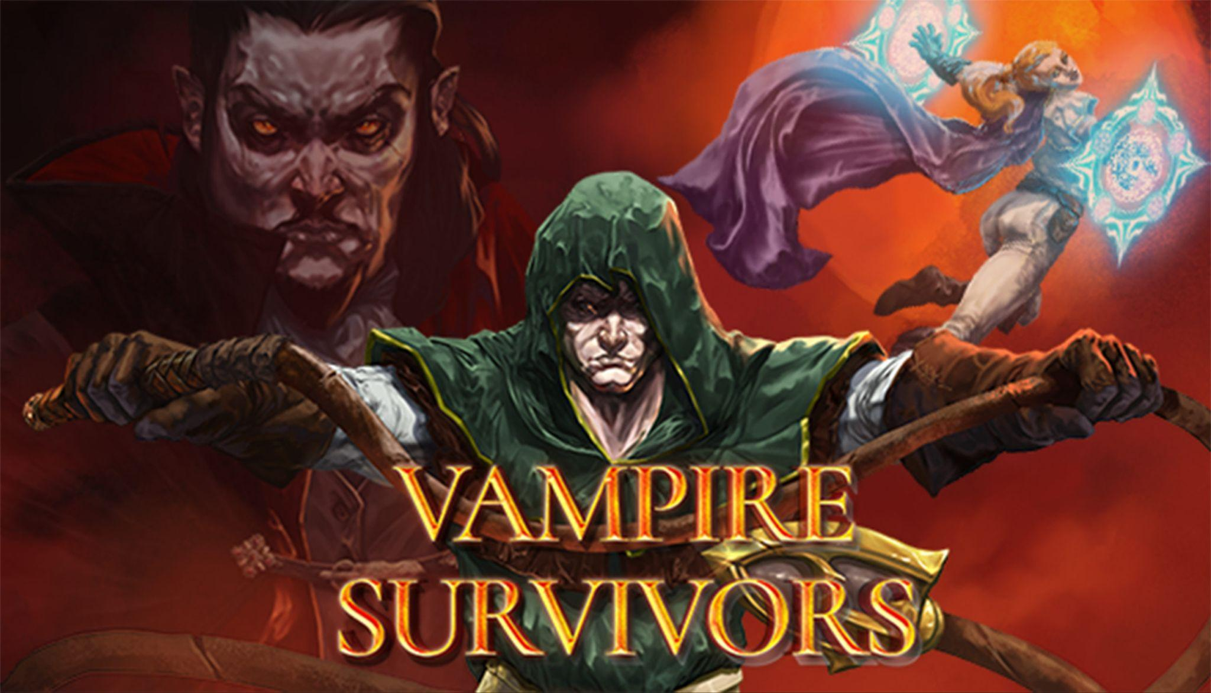
Vampire Survivors - One of the most baffling Indie success stories
Perhaps the direct opposite of Crucible is Vampire Survivors.
This game started as a free demo on Itch.io as a project for the solo developer to do during the weekend while he was unemployed.
It was based on a mobile game called “Magic Survival”, which had done well, but was hardly on the map. It was just something that he personally enjoyed playing. No market analysis, just something he wanted to make.
It was built using pre-made or very quickly made assets, costing the developer around £1,100.
Since its release to Steam, it was updated almost weekly with new maps, characters, weapons, power-ups and story, and has allowed the solo dev to hire a team to work on the game until it’s full release in late 2022.
Within two years, the game has become a sensation, with multiple award nominations across at least 7 major events (competing with much bigger titles from much larger developers), several DLCs and even (bafflingly) a TV series.
It has inspired an entire sub-genre of games that seek to emulate its game-play and success

Slide 28
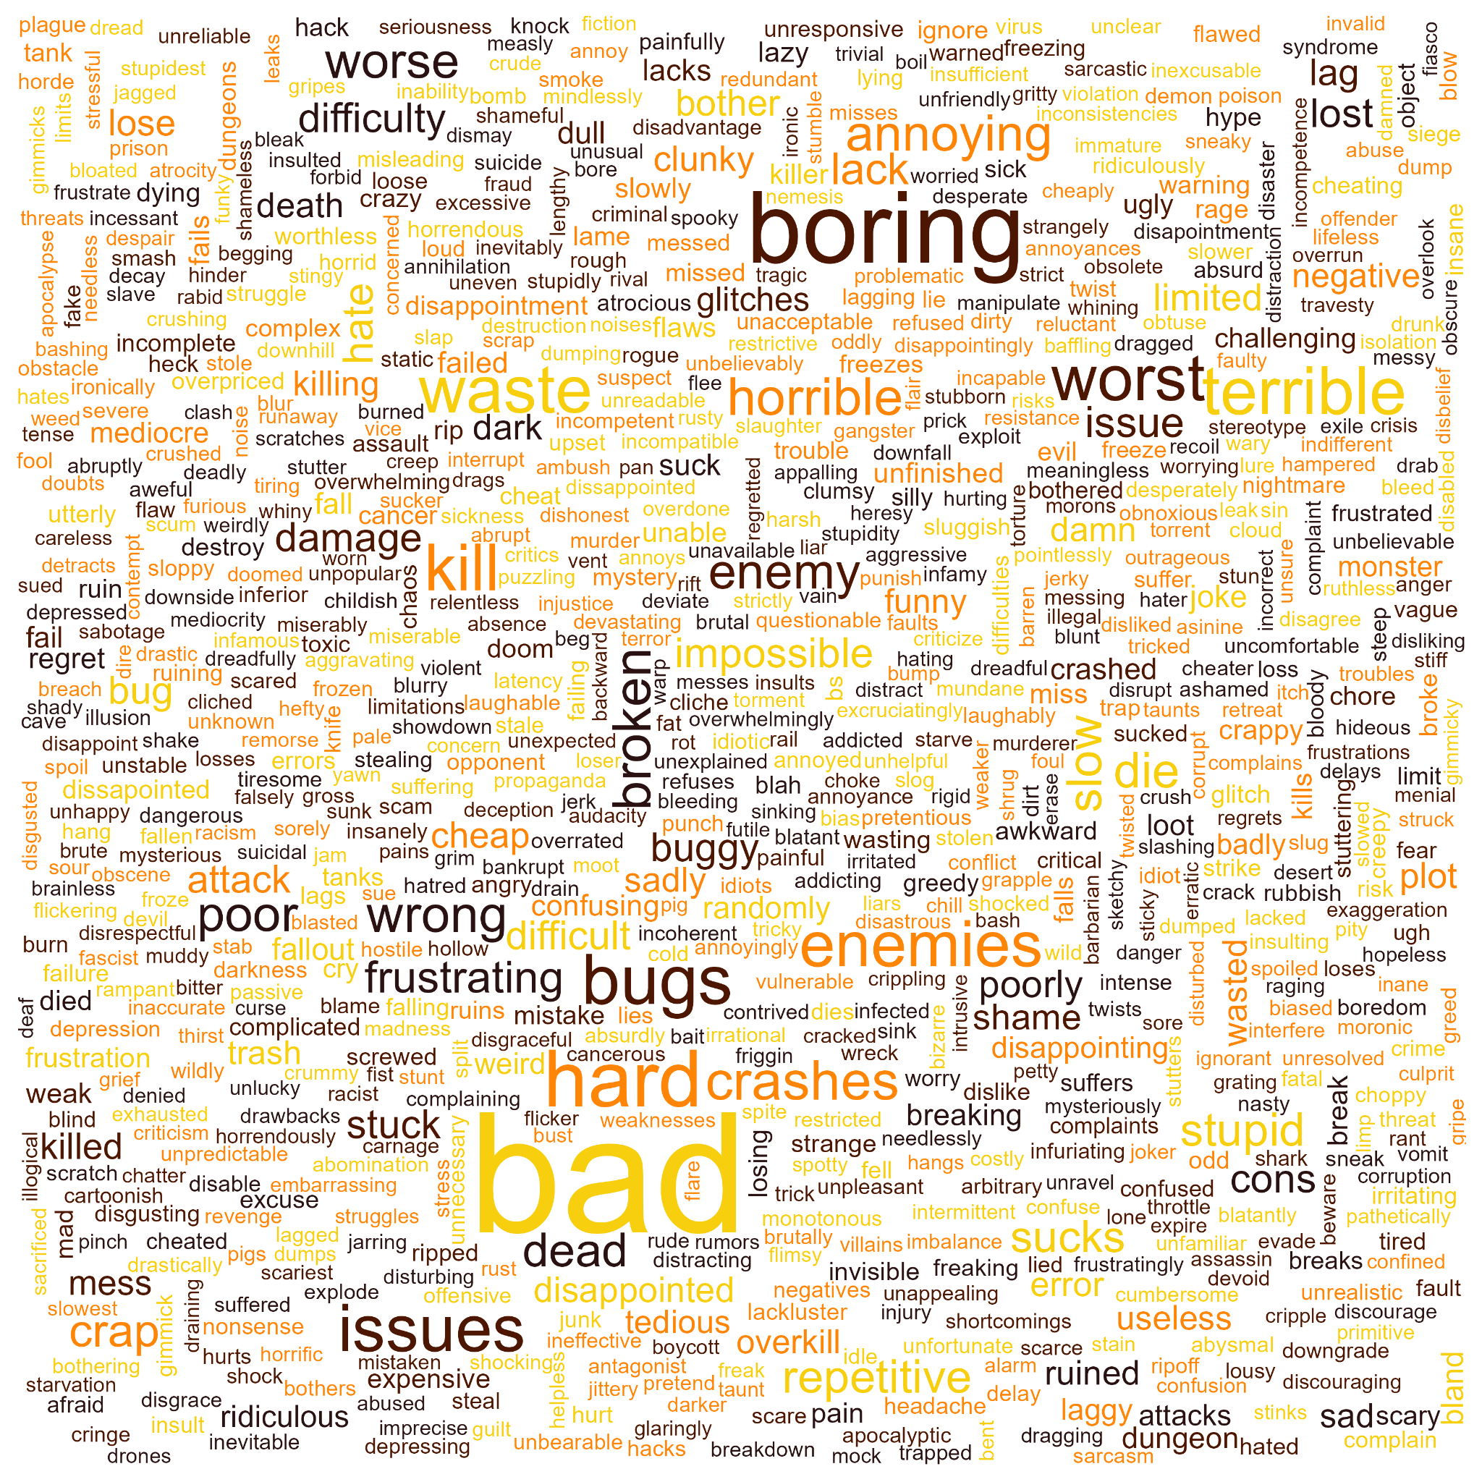
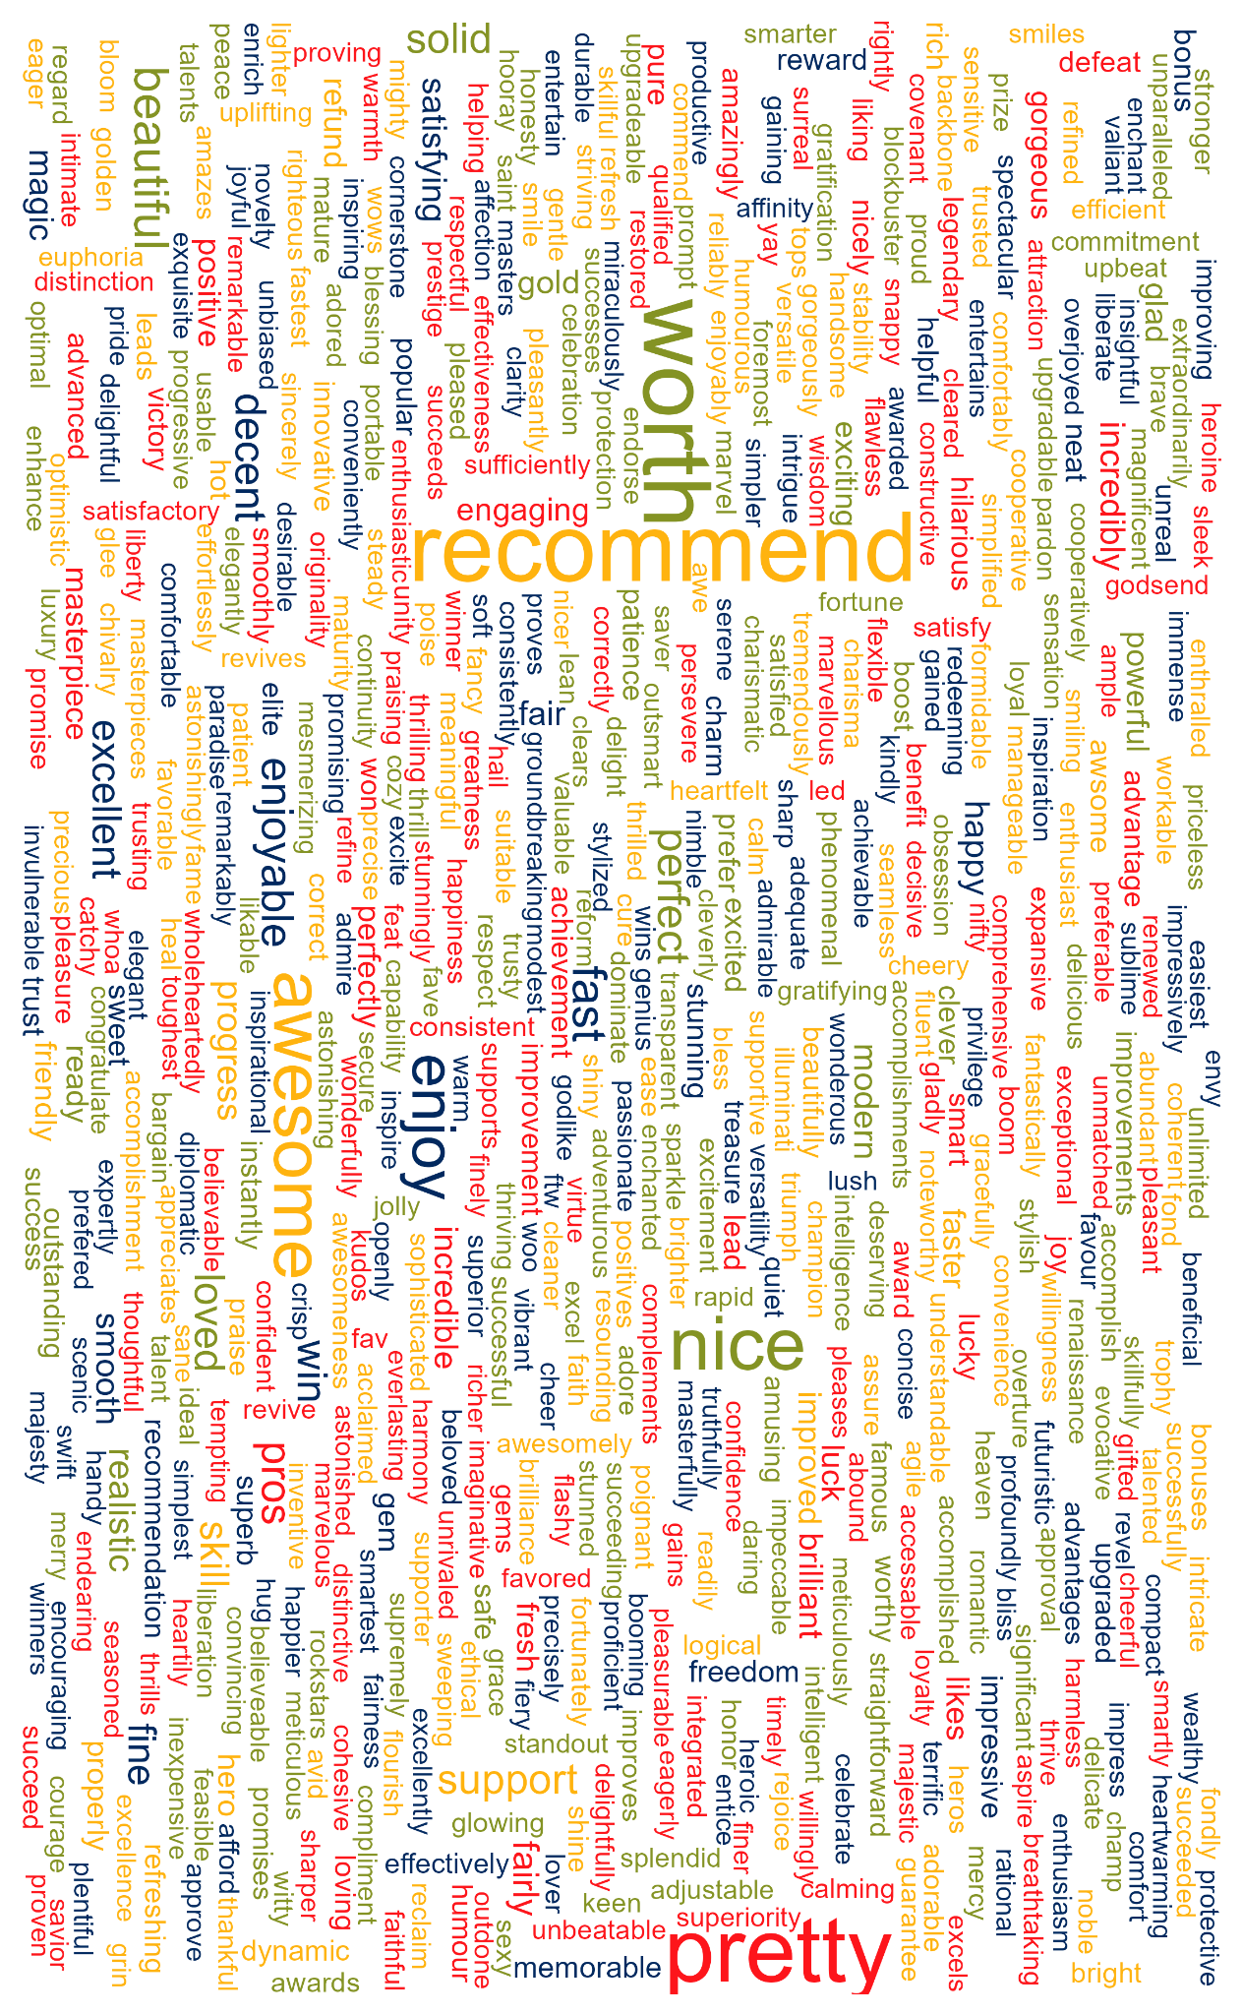
Thanks for listening!
Sorry about all the rubbish colour schemes!
(they used to be much worse)(also there’s no cat in this one sorry)

